Slide 1
NIVEAU 2
3- My town
3.5- India
Step 2

Slide 2
Tongue Twister

Slide 3
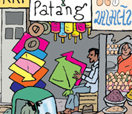
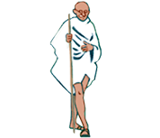
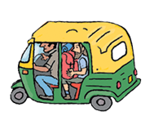
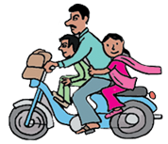
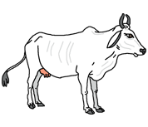
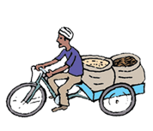
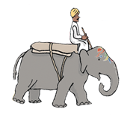
Listen and repeat

Slide 4
What’s missing ?

Slide 5
What’s missing ?

Slide 6
What’s missing ?

Slide 7
What’s missing ?

Slide 8
What’s missing ?

Slide 9
What’s missing ?

Slide 10
What’s missing ?

Slide 11
Look and say what you can.

Slide 12
Play memory

Slide 13
What have we learned ?
a kite shop
an autorickshaw
Gandhi
a moped
a sacred cow
an elephant driver
a delivery tricycle

