Slide 1
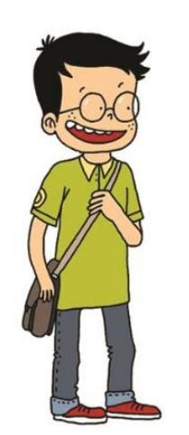
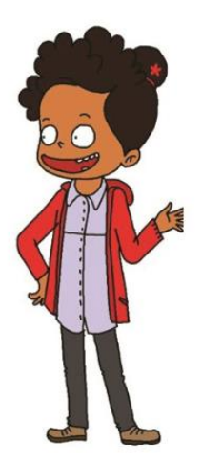
NIVEAU 2
4- My hobbies
4.2- Internet activities
Step 1

Slide 2
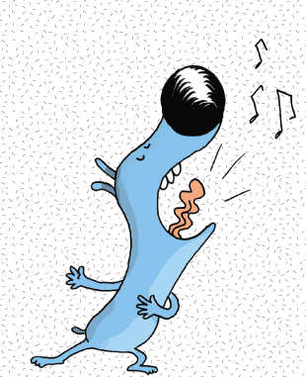
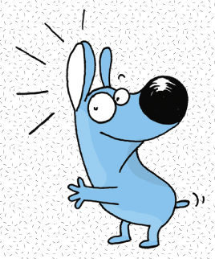
Tongue Twister

Slide 3
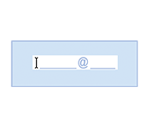
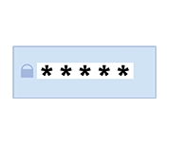
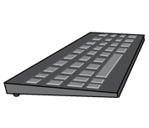
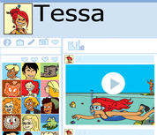
Listen and repeat

Slide 4
What’s missing ?

Slide 5
What’s missing ?

Slide 6
What’s missing ?

Slide 7
What’s missing ?

Slide 8
What’s missing ?

Slide 9
What’s missing ?

Slide 10
What’s missing ?

Slide 11
What’s missing ?

Slide 12
What’s missing ?

Slide 13
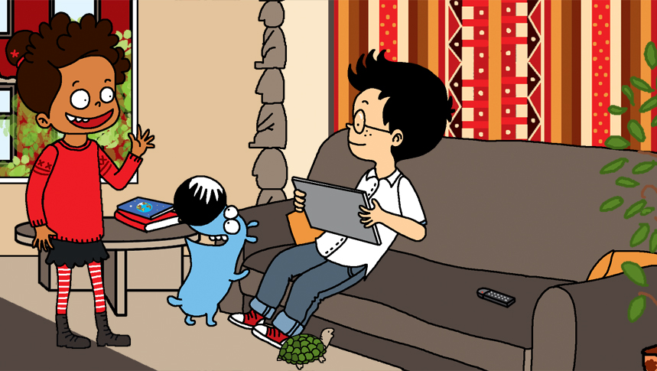
Look and say what you can.

Slide 14
What’s missing ?

Slide 15
What’s missing ?

Slide 16
What’s missing ?

Slide 17
What’s missing ?

Slide 18
What’s missing ?

Slide 19
What’s missing ?

Slide 20
What’s missing ?

Slide 21
What’s missing ?

Slide 22
What’s missing ?

Slide 23
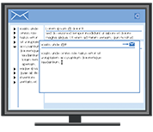
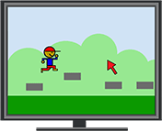
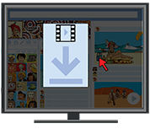
Listen and click on the right picture.
1/6

Slide 24
Listen and click on the right picture.
2/6

Slide 25
Listen and click on the right picture.
3/6

Slide 26
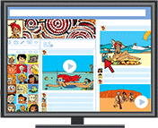
Listen and click on the right picture.
4/6

Slide 27
Listen and click on the right picture.
5/6

Slide 28
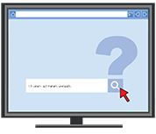
Listen and click on the right picture.
6/6

Slide 29
What have we learned ?
a website
a tablet
an email adress
a social network
a password
to download
a keyboard
a video
a file

