Slide 1
NIVEAU 2
4- My hobbies
4.1- Beach activities
Step 2

Slide 2
Tongue Twister
Thirty thousand feathers around the thrush’s throat.

Slide 3
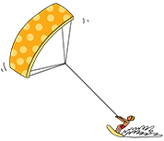
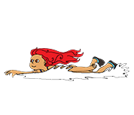
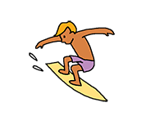
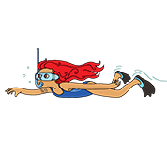
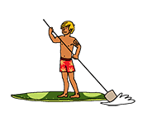
What’s missing ?

Slide 4
What’s missing ?

Slide 5
What’s missing ?

Slide 6
What’s missing ?

Slide 7
What’s missing ?

Slide 8
What’s missing ?

Slide 9
What’s missing ?

Slide 10
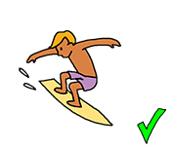
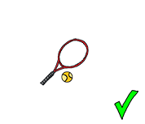
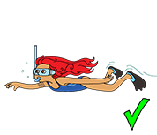
Listen and click on the right picture.
1/5

Slide 11
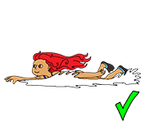
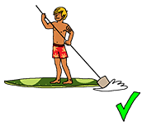
Listen and click on the right picture.
2/5

Slide 12
Listen and click on the right picture.
3/5

Slide 13
Listen and click on the right picture.
4/5

Slide 14
Listen and click on the right picture.
5/5

Slide 15
Listen and click on the right picture.
I can surf.
I can swim.
I can dive.
1/5

Slide 16
Listen and click on the right picture.
I can paddle-board.
I can play tennis.
I can surf.
2/5

Slide 17
Listen and click on the right picture.
I can play tennis.
I can paddle-board.
I can swim.
3/5

Slide 18
Listen and click on the right picture.
I can paddle-board.
I can play tennis.
I can surf.
4/5

Slide 19
Listen and click on the right picture.
I can swim.
I can play tennis.
I can surf.
5/5

Slide 20
Look, listen and focus on what you understand.

Slide 21
Look, listen and focus on what you understand.
Lucy: “Oh! I’ve received an email from Tessa! She’s in Australia right now!
Let’s open it! Ummmm... There’s a link! Cool! There are photos attached ! I’m going to download them!”
Lucy: “Look! It looks so nice! The weather is so beautiful!”
Tom: “Yes! Oh! They’re surfing! And look at this one! He’s Kite surfing! I love kitesurfing! Do you like it Lucy?”
Lucy: “I don’t know. I’ve never tried...”
Tom: “Oh! She’s diving in this picture!”
Lucy: “This is nice! Can you dive Tom?”
Tom: “Yes, I can! I love diving! She’s very lucky!”

Slide 22
What’s missing ?

Slide 23
What’s missing ?

Slide 24
What’s missing ?

Slide 25
What’s missing ?

Slide 26
What’s missing ?

Slide 27
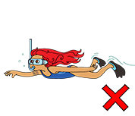
Listen and click on the right picture.
1/5

Slide 28
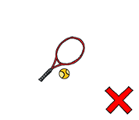
Listen and click on the right picture.
2/5

Slide 29
Listen and click on the right picture.
3/5

Slide 30
Listen and click on the right picture.
4/5

Slide 31
Listen and click on the right picture.
5/5

Slide 32
What have we learned ?
- Can you play tennis ?
- No, I can’t.
- Can you surf ?
- Yes, I can.
- Can you paddle-board ?
- Yes, I can.
- Can you dive ?
- No, I can’t.

