Slide 1
NIVEAU 2
4- My hobbies
4.1- Beach activities
Step 1

Slide 2
Tongue Twister

Slide 3
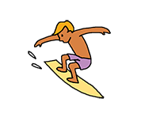
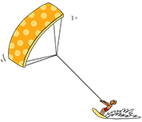
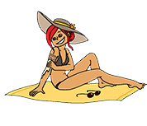
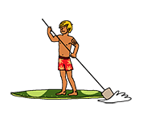
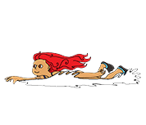
Listen and repeat

Slide 4
What’s missing ?

Slide 5
What’s missing ?

Slide 6
What’s missing ?

Slide 7
What’s missing ?

Slide 8
What’s missing ?

Slide 9
What’s missing ?

Slide 10
What’s missing ?

Slide 11
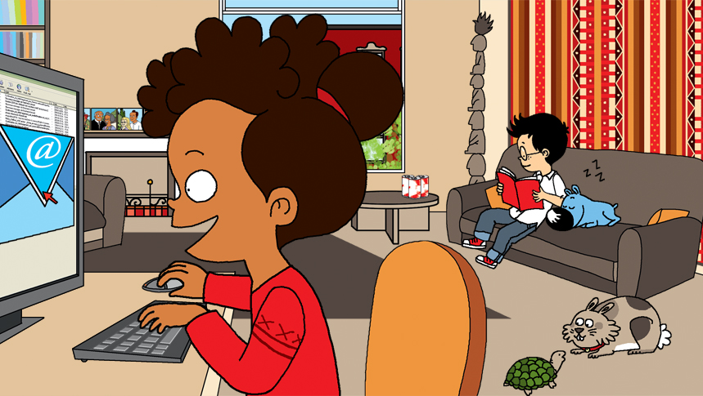
Look and say what you can.

Slide 12
Look, listen and focus on what you understand.

Slide 13
What’s missing ?

Slide 14
What’s missing ?

Slide 15
What’s missing ?

Slide 16
What’s missing ?

Slide 17
What’s missing ?

Slide 18
What’s missing ?

Slide 19
What’s missing ?

Slide 20
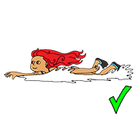
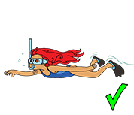
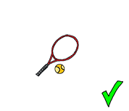
Listen and click on the right picture.
1/5

Slide 21
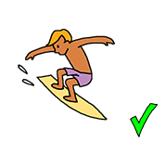
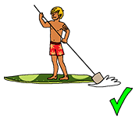
Listen and click on the right picture.
2/5

Slide 22
Listen and click on the right picture.
3/5

Slide 23
Listen and click on the right picture.
4/5

Slide 24
Listen and click on the right picture.
5/5

Slide 25
What have we learned ?
a surf
paddle-boarding
kite surfing
diving
sunbathing
swimming
sunscreen

