Slide 1
3- My town
3. 4- My new glasses
Step 2

Slide 2
Tongue Twister
Extra, extra ! Exton exclaimed excitedly.

Slide 3
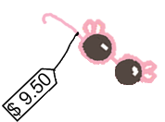
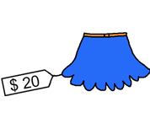
Listen and click on the right picture.
1/4

Slide 4
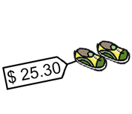
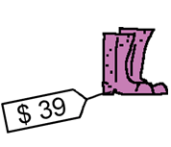
Listen and click on the right picture.
2/4

Slide 5
Listen and click on the right picture.
3/4

Slide 6
Listen and click on the right picture.
4/4

Slide 7
Listen and click on the right picture.
1/3

Slide 8
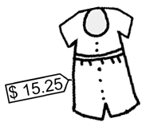
Listen and click on the right picture.
2/3

Slide 9
Listen and click on the right picture.
3/3

Slide 10
Look, listen and describe.

Slide 11
Look, listen and focus on what you understand.
Lucy: “Oh! There are sun glasses as well! Ouh! I like the pink ones! They’re beautiful!”
Lucy: “What do you think Tom?”
Tom: “They’re nice!”
Lucy: “Ok, I take them!”
Lucy: “How much are they please?”
Seller: “They’re 9 dollars and 50 cents.”
Seller: “Here you are!”
Lucy: “Thank you!”
Seller: “You’re welcome!”

Slide 12
Listen and click on the right picture.

Slide 13
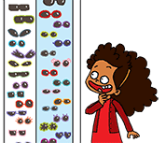
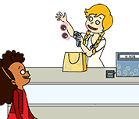
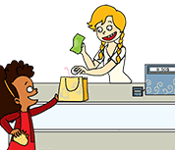
Listen and click on the right picture.

Slide 14
What have we learned ?
What is it?
Qu’est-ce que c’est ?
- It’s + adjective + nom. (It’s an orange coat).
C’est + adjectif + nom (C’est un manteau orange).
I would like + nom (I would like sunglasses)
J’aimerais + nom (J’aimerais des lunettes de soleil).
- How much is it ?
Combien ça coûte ?
- It’s 20 dollars.
C’est 20 dollars.
Here you are.
Voilà.
Thank you !
Merci
- You’re welcome !
De rien.

