Slide 1
3- My town
3. 4- My new glasses
Step 1

Slide 2
Tongue Twister

Slide 3
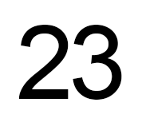
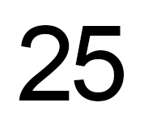
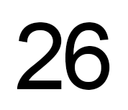
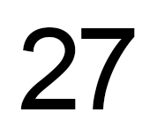
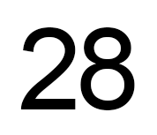
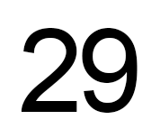
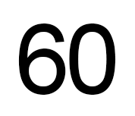
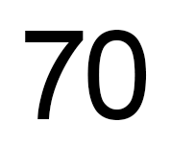
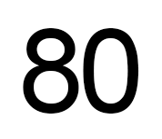
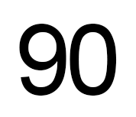
Listen and repeat

Slide 4
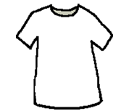
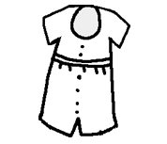
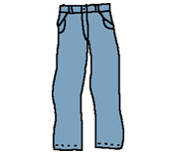
What’s missing ?

Slide 5
What’s missing ?

Slide 6
What’s missing ?

Slide 7
What’s missing ?

Slide 8
What’s missing ?

Slide 9
What’s missing ?

Slide 10
What’s missing ?

Slide 11
What’s missing ?

Slide 12
What’s missing ?

Slide 13
What’s missing ?

Slide 14
What’s missing ?

Slide 15
What’s missing ?

Slide 16
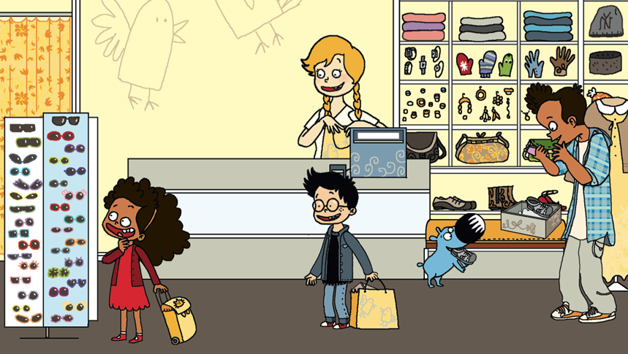
Look and say what you can.

Slide 17
Look, listen and describe.

Slide 18
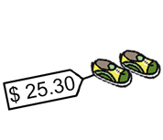
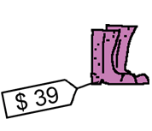
Listen and click on the right picture.
1/4

Slide 19
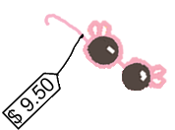
Listen and click on the right picture.
2/4

Slide 20
Listen and click on the right picture.
3/4

Slide 21
Listen and click on the right picture.
4/4

Slide 22
Listen and click on the right picture.
1/6

Slide 23
Listen and click on the right picture.
2/6

Slide 24
Listen and click on the right picture.
3/6

Slide 25
Listen and click on the right picture.
4/6

Slide 26
Listen and click on the right picture.
5/6

Slide 27
Listen and click on the right picture.
6/6

Slide 28
What have we learned ?
twenty
seventy
thirty
eighty
forty
ninety
fifty
a hundred
sixty

