Slide 1
NIVEAU 2
3- My town
3.4- Let’s count !
Step 2

Slide 2
Tongue Twister
Mister tongue twister tried to train his tongue to twist and turn to learn the letter T.

Slide 3
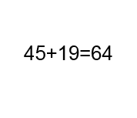
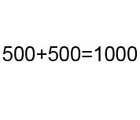
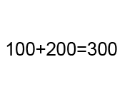
Listen and click on the right picture.
1/6

Slide 4
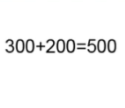
Listen and click on the right picture.
2/6

Slide 5
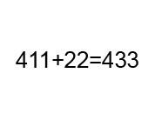
Listen and click on the right picture.
3/6

Slide 6
Listen and click on the right picture.
4/6

Slide 7
Listen and click on the right picture.
5/6

Slide 8
Listen and click on the right picture.
6/6

Slide 9
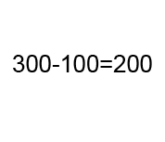
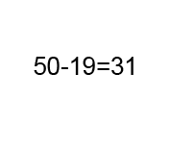
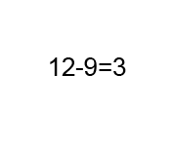
Listen and click on the right picture.
1/6

Slide 10
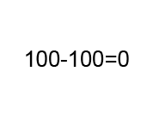
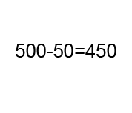
Listen and click on the right picture.
2/6

Slide 11
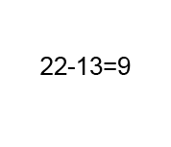
Listen and click on the right picture.
3/6

Slide 12
Listen and click on the right picture.
4/6

Slide 13
Listen and click on the right picture.
5/6

Slide 14
Listen and click on the right picture.
6/6

Slide 15
Look, listen and focus on what you understand.

Slide 16
Look, listen and focus on what you understand.
Tom: “All right then! How much are they please?”
Kite seller: “The rainbow-coloured kite is at 625 Indian rupees
and the other ones are at 499 rupees.”
Tom: “Ok, thanks! I don’t have enough rupees left... Can we go to the bank?”
Lucy’s mother: “Ok, let’s go to the bank!”
Lucy: “499 rupees... Umm! How much is that in dollars?”
Tom: “Ummm... Let me see... 7 dollars and 50 cents... or 5 pounds!
Hi! I’d like to change 10 dollars please.”
Change employee: “Here you are! 632 rupees!”
Tom: “Thank you! Can I have a receipt please?”

Slide 17
Listen and click on the right picture.
1/6

Slide 18
Listen and click on the right picture.
2/6

Slide 19
Listen and click on the right picture.
3/6

Slide 20
Listen and click on the right picture.
4/6

Slide 21
Listen and click on the right picture.
5/6

Slide 22
Listen and click on the right picture.
6/6

Slide 23
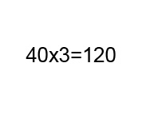
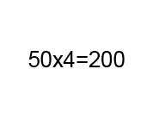
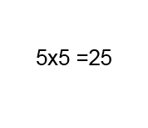
Listen and click on the right picture.
1/6

Slide 24
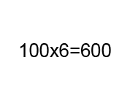
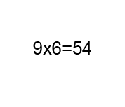
Listen and click on the right picture.
2/6

Slide 25
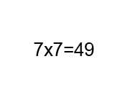
Listen and click on the right picture.
3/6

Slide 26
Listen and click on the right picture.
4/6

Slide 27
Listen and click on the right picture.
5/6

Slide 28
Listen and click on the right picture.
6/6

Slide 29
What have we learned ?
45 + 19 = 64 : forty five plus nineteen equals sixty four
12 - 9 = 3 : twelve minus nine equals three
40 x 3 = 120: forty times three equals one hundred twenty

