Slide 1
NIVEAU 2
3- My town
3.4- Let’s count !
Step 1

Slide 2
Tongue Twister

Slide 3
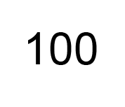
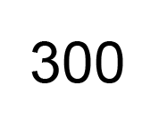
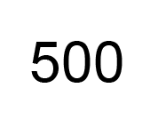
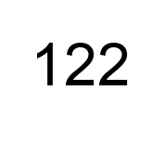
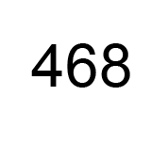
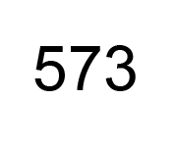
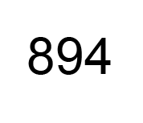
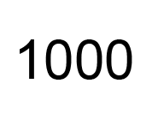
Listen and repeat

Slide 4
What’s missing ?

Slide 5
What’s missing ?

Slide 6
What’s missing ?

Slide 7
What’s missing ?

Slide 8
What’s missing ?

Slide 9
What’s missing ?

Slide 10
What’s missing ?

Slide 11
What’s missing ?

Slide 12
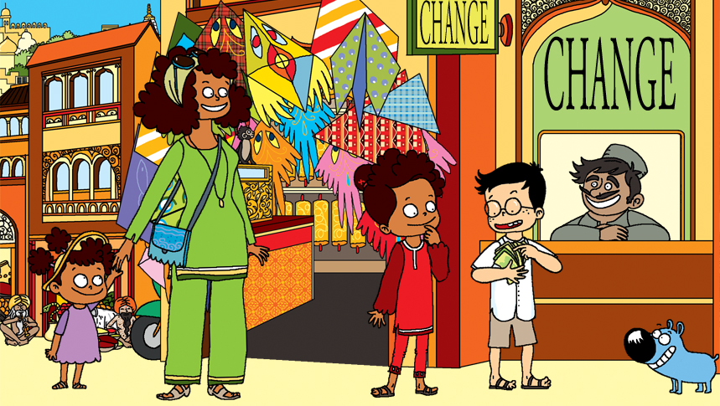
Look and say what you can.

Slide 13
Look, listen and focus on what you understand.

Slide 14
What’s missing ?

Slide 15
What’s missing ?

Slide 16
What’s missing ?

Slide 17
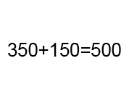
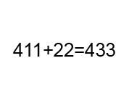
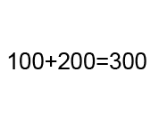
Listen and click on the right picture.
1/6

Slide 18
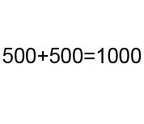
Listen and click on the right picture.
2/6

Slide 19
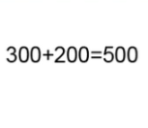
Listen and click on the right picture.
3/6

Slide 20
Listen and click on the right picture.
4/6

Slide 21
Listen and click on the right picture.
5/6

Slide 22
Listen and click on the right picture.
6/6

Slide 23
What have we learned ?
1 : one 2 : two 3 : three 4 : four
5 : five 6 : six 7 : seven 8 : eight
9 : nine 10 : ten 11 : eleven 12 : twelve
13 : thirteen 14 : fourteen 15 : fifteen 16 : sixteen
17 : seventeen 18 : eighteen 19 : nineteen
20 : twenty 21 : twenty-one 22 : twenty-two 23 : twenty-three
24 : twenty-four 25 : twenty-five 26 : twenty-six 27 : twenty-seven
28 : twenty-eight 29 : twenty-nine
30 : thirty 40 : fourty 50 : fifty 60 : sixty
70 : seventy 80 : eighty 90 : ninety
100 : one hundred 300 : three hundred 500 : five hundred
1 000 : one thousand

