Slide 1
3- My town
3. 3- In the clothing store
Step 2

Slide 2
Tongue Twister
Extra, extra ! Exton exclaimed excitedly.

Slide 3
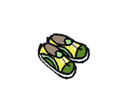
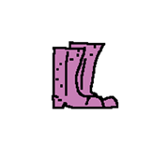
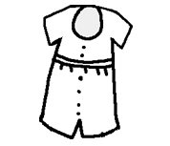
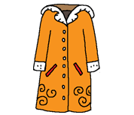
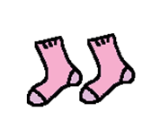
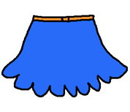
What’s missing ?

Slide 4
What’s missing ?

Slide 5
What’s missing ?

Slide 6
What’s missing ?

Slide 7
What’s missing ?

Slide 8
What’s missing ?

Slide 9
What’s missing ?

Slide 10
Listen and click on the right picture.
1/6

Slide 11
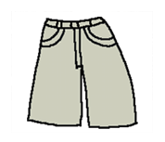
Listen and click on the right picture.
2/6

Slide 12
Listen and click on the right picture.
3/6

Slide 13
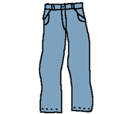
Listen and click on the right picture.
4/6

Slide 14
Listen and click on the right picture.
5/6

Slide 15
Listen and click on the right picture.
6/6

Slide 16
Look, listen and describe.

Slide 17
Look, listen and focus on what you understand.
Seller: “Hi! Can I help you?” Tom: “Hi! I’d like new shoes!” Seller: “Ok. Ummm... Let me see... What are you wearing today? You’re wearing jeans with a black jumper... Let me find something for you!” Seller: “Here I am! I have these nice green shoes and these beautiful grey shoes as well. Do you like them?” Lucy: “I like the grey shoes!” Tom: “I prefer the green shoes! Can I try them on?”
Seller: “Do you like them?” Tom: “Yes, they’re really nice!” Lucy: “They’re beautiful!”

Slide 18
Listen and click on the right picture.
1/6

Slide 19
Listen and click on the right picture.
2/6

Slide 20
Listen and click on the right picture.
3/6

Slide 21
Listen and click on the right picture.
4/6

Slide 22
Listen and click on the right picture.
5/6

Slide 23
Listen and click on the right picture.
6/6

Slide 24
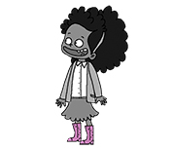
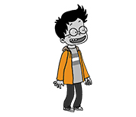
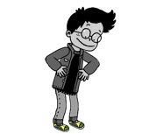
Listen and click on the right picture.
1/4

Slide 25
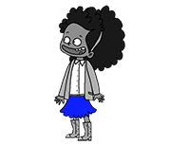
Listen and click on the right picture.
2/4

Slide 26
Listen and click on the right picture.
3/4

Slide 27
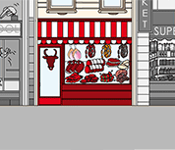
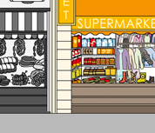
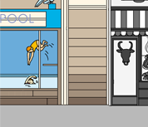
Listen and click on the right picture.
4/5

Slide 28
Listen and click on the right picture.
4/4

Slide 29
What have we learned ?
What are you wearing today?
Qu’est-ce que tu portes aujourd’hui ?
- Today, I'm wearing green shoes
Aujourd’hui, je porte des chaussures vertes ?
What is he / she wearing today?
Qu’est-ce qu’il / qu’elle porte aujourd’hui ?
- Today, he’s / she’s wearing …
Aujourd’hui, il / elle porte …

