Slide 1
3- My town
3. 3- In the clothing store
Step 1

Slide 2
Tongue Twister

Slide 3
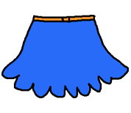
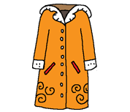
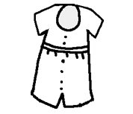
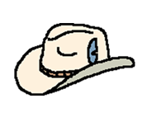
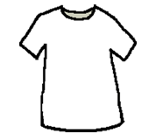
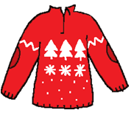
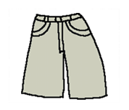
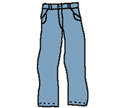
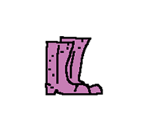
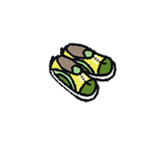
Listen and repeat

Slide 4
What’s missing ?

Slide 5
What’s missing ?

Slide 6
What’s missing ?

Slide 7
What’s missing ?

Slide 8
What’s missing ?

Slide 9
What’s missing ?

Slide 10
What’s missing ?

Slide 11
What’s missing ?

Slide 12
What’s missing ?

Slide 13
What’s missing ?

Slide 14
What’s missing ?

Slide 15
What’s missing ?

Slide 16
Listen and repeat

Slide 17
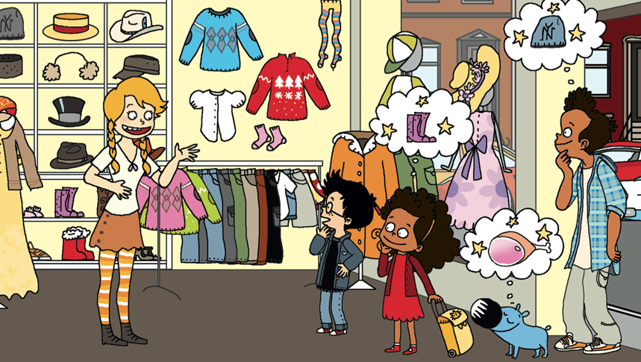
Look and say what you can.

Slide 18
Look, listen and describe.

Slide 19
What’s missing ?

Slide 20
What’s missing ?

Slide 21
What’s missing ?

Slide 22
What’s missing ?

Slide 23
What’s missing ?

Slide 24
What’s missing ?

Slide 25
What’s missing ?

Slide 26
What’s missing ?

Slide 27
What’s missing ?

Slide 28
What’s missing ?

Slide 29
What’s missing ?

Slide 30
What’s missing ?

Slide 31
What’s missing ?

Slide 32
What’s missing ?

Slide 33
What’s missing ?

Slide 34
What’s missing ?

Slide 35
What’s missing ?

Slide 36
What’s missing ?

Slide 37
What’s missing ?

Slide 38
What’s missing ?

Slide 39
What’s missing ?

Slide 40
What’s missing ?

Slide 41
Listen and repeat

Slide 42
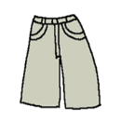
What have we learned ?
a dress
green shoes
a hat
purple boots
a t-shirt
a white shirt
a jumper
pink socks
trousers
an orange coat
shorts
a blue skirt

