Slide 1
NIVEAU 2
3- My town
3.3- At the kite shop
Step 2

Slide 2
Tongue Twister
Shut the shutters and sit in the shop.

Slide 3
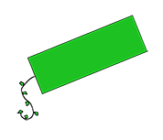
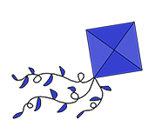
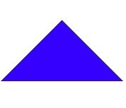
What’s missing ?

Slide 4
What’s missing ?

Slide 5
What’s missing ?

Slide 6
What’s missing ?

Slide 7
What’s missing ?

Slide 8
What’s missing ?

Slide 9
What’s missing ?

Slide 10
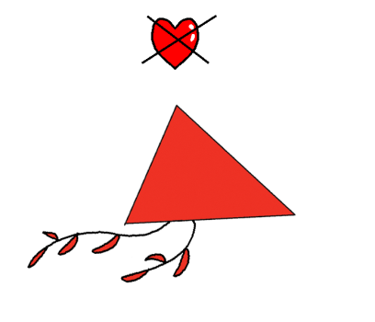
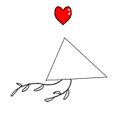
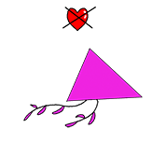
Listen and click on the right picture.
1/6

Slide 11
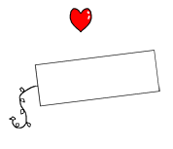
Listen and click on the right picture.
2/6

Slide 12
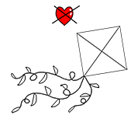
Listen and click on the right picture.
3/6

Slide 13
Listen and click on the right picture.
4/6

Slide 14
Listen and click on the right picture.
5/6

Slide 15
Listen and click on the right picture.
6/6

Slide 16
Look, listen and focus on what you understand.

Slide 17
Look, listen and focus on what you understand.
Tom: “Oh! This shop is amazing. There are lots of kites!”
Kite Seller: “Can I help you?”
Lucy: “Yes, we’re looking for kites please!”
Kite Seller: “Great! You’re in the right place!”
Kite Seller: “How many kites would you like?”
Lucy: “One for my sister, one for Tom and one for me!”
Kite Seller: “Ok, 3 kites. What kind of kite would you like? We have everything you want.”
Lucy’s little sister: “I like the rainbow-coloured kite! I want this one!”
Lucy: “I’d like... the striped kite... Oh no, this one! The red triangular kite!”
Tom: “I’d like a green one... I’m not sure if I’ll choose a square kite or a rectangular kite...
What do you think Lucy?”
Lucy: “I prefer the square kite!”

Slide 18
Listen and click on the right picture.
I like blue kites.
I don’t like big red kites.
I don’t like square kites.
1/4

Slide 19
Listen and click on the right picture.
I don’t like square kites.
I like triangular kites.
I don’t like big red kites.
2/4

Slide 20
Listen and click on the right picture.
I don’t like square kites.
I don’t like big red kites.
I like triangular kites.
3/4

Slide 21
Listen and click on the right picture.
I like triangular kites.
I don’t like square kites.
I don’t like big red kites.
4/4

Slide 22
Practise your dialogue.

Slide 23
Listen and click on the right picture.
What would you like ?
A triangular kite.
What would you like ?
A red triangular kite, please.
What would you like ?
A rectangular kite, please.
What would you like ?
A square kite, please.
What would you like ?
A blue kite, please.
What would you like ?
A green rectangular kite, please.

Slide 24
What have we learned ?
I like rectangular kites.
I like triangular kites.
I don’t like square kites.
- What would you like ?
- A rectangular kite, please.
- What would you like ?
- A triangular kite.
- What would you like ?
- A square kite, please.

