Slide 1
NIVEAU 2
3- My town
3.3- At the kite shop
Step 1

Slide 2
Tongue Twister

Slide 3
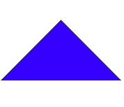
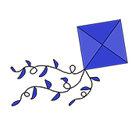
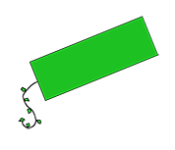
Listen and repeat

Slide 4
What’s missing ?

Slide 5
What’s missing ?

Slide 6
What’s missing ?

Slide 7
What’s missing ?

Slide 8
What’s missing ?

Slide 9
What’s missing ?

Slide 10
What’s missing ?

Slide 11
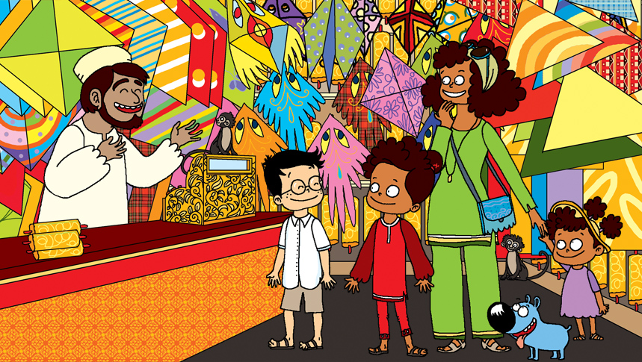
Look and say what you can.

Slide 12
Look, listen and focus on what you understand.

Slide 13
What’s missing ?

Slide 14
What’s missing ?

Slide 15
What’s missing ?

Slide 16
What’s missing ?

Slide 17
What’s missing ?

Slide 18
What’s missing ?

Slide 19
What’s missing ?

Slide 20
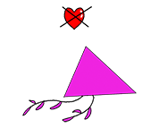
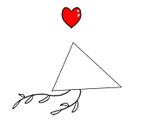
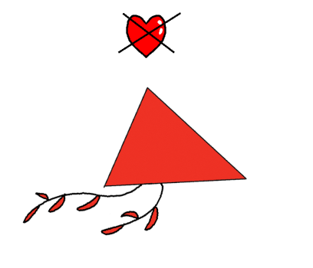
Listen and click on the right picture.
1/6

Slide 21
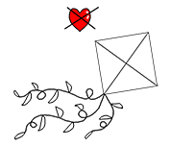
Listen and click on the right picture.
2/6

Slide 22
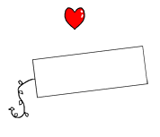
Listen and click on the right picture.
3/6

Slide 23
Listen and click on the right picture.
4/6

Slide 24
Listen and click on the right picture.
5/6

Slide 25
Listen and click on the right picture.
6/6

Slide 26
What have we learned ?
a square
a red triangular kite
a triangle
a blue square kite
a rectangle
a green rectangular kite
a rainbow coloured kite

