Slide 1
NIVEAU 2
3- My town
3.2- At the restaurant
Step 1

Slide 2
Tongue Twister
I thought of thinking of thanking you.

Slide 3
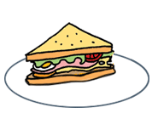
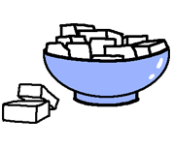
What’s missing ?

Slide 4
What’s missing ?

Slide 5
What’s missing ?

Slide 6
What’s missing ?

Slide 7
What’s missing ?

Slide 8
What’s missing ?

Slide 9
What’s missing ?

Slide 10
What’s missing ?

Slide 11
Listen and click on the right picture.
1/8

Slide 12
Listen and click on the right picture.
2/8

Slide 13
Listen and click on the right picture.
3/8

Slide 14
Listen and click on the right picture.
4/8

Slide 15
Listen and click on the right picture.
5/8

Slide 16
Listen and click on the right picture.
6/8

Slide 17
Listen and click on the right picture.
7/8

Slide 18
Listen and click on the right picture.
8/8

Slide 19
Look, listen and focus on what you understand.

Slide 20
Look, listen and focus on what you understand.
Tom: “It was fun! Gosh! I’m hungry!”
Lucy: “Yes, so am I. And I’m thirsty as well.”
Lucy’s mother: “Let’s go and have something to eat!”
Lucy: “Yeah! Let’s have a curry!”
Waitress: “What would you like for lunch?”
Lucy’s mother: “We’d like 4 vegetable curries with rice
and for the dessert, we’d like jalebis please.”
Waitress: “Ok! Do you like when it’s spicy or sweet?”
Lucy : “Sweet please!”
Tom : “I like when it’s spicy!”
Lucy’s mother: “Can we have 3 sweet curries and a spicy one please? Thank you!”
Waitress: “Here you are! Have a nice meal!”
Tom: “Thank you!”
Lucy’s mother: “Thank you very much!”
Lucy’s little sister: “Yummy!”
Lucy: “It’s delicious!”

Slide 21
Listen and click on the right picture.

Slide 22
Listen and click on the right picture.
How much is it ?
It’s 30 rupees.
How much is it ?
It’s 100 rupees.
How much is it ?
It’s 10 rupees.
1/5

Slide 23
Listen and click on the right picture.
How much is it ?
It’s 15 rupees.
How much is it ?
It’s 25 rupees.
How much is it ?
It’s 30 rupees.
2/5

Slide 24
Listen and click on the right picture.
How much is it ?
It’s 10 rupees.
How much is it ?
It’s 30 rupees.
How much is it ?
It’s 15 rupees.
3/5

Slide 25
Listen and click on the right picture.
How much is it ?
It’s 100 rupees.
How much is it ?
It’s 25 rupees.
How much is it ?
It’s 10 rupees.
4/5

Slide 26
Listen and click on the right picture.
How much is it ?
It’s 45 rupees.
How much is it ?
It’s 15 rupees.
How much is it ?
It’s 25 rupees.
5/5

Slide 27
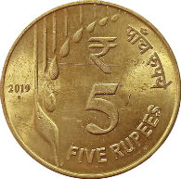
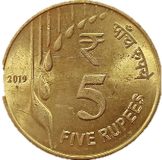
What have we learned ?
- Can I have a sandwich, please ?
Puis-je avoir un sandwich, s’il-vous-plaît ?
- Here you are.
Voilà
- Thank you.
Merci
- How much is it ?
Combien ça coûte ?
rupee = roupie
C’est le nom de la monnaie en Inde.
- It’s 15 rupees.
C’est 15 roupies.

