Slide 1
NIVEAU 2
3- My town
3.2- At the restaurant
Step 1

Slide 2
Tongue Twister

Slide 3
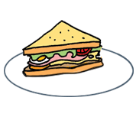
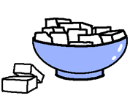
Listen and repeat

Slide 4
What’s missing ?

Slide 5
What’s missing ?

Slide 6
What’s missing ?

Slide 7
What’s missing ?

Slide 8
What’s missing ?

Slide 9
What’s missing ?

Slide 10
What’s missing ?

Slide 11
What’s missing ?

Slide 12
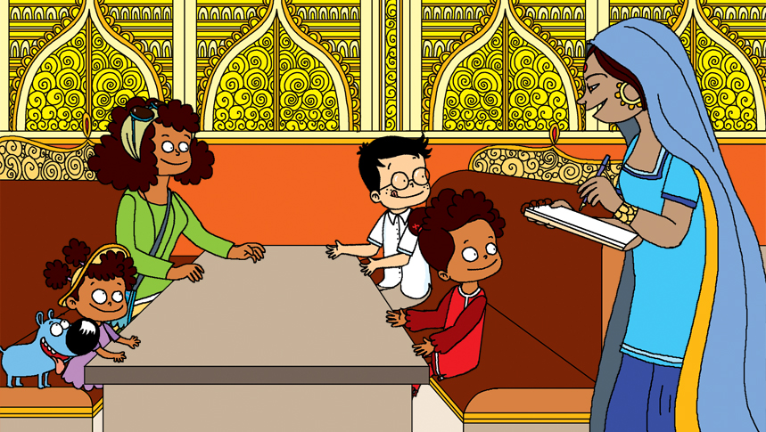
Look and say what you can.

Slide 13
Look, listen and focus on what you understand.

Slide 14
What’s missing ?

Slide 15
What’s missing ?

Slide 16
What’s missing ?

Slide 17
What’s missing ?

Slide 18
What’s missing ?

Slide 19
What’s missing ?

Slide 20
What’s missing ?

Slide 21
What’s missing ?

Slide 22
Listen and click on the right picture.
1/8

Slide 23
Listen and click on the right picture.
2/8

Slide 24
Listen and click on the right picture.
3/8

Slide 25
Listen and click on the right picture.
4/8

Slide 26
Listen and click on the right picture.
5/8

Slide 27
Listen and click on the right picture.
6/8

Slide 28
Listen and click on the right picture.
7/8

Slide 29
Listen and click on the right picture.
8/8

Slide 30
What have we learned ?
a sandwich
tea
a curry
bread
a lemon
rice
a cake
sugar
Can I have a sandwich, please ?
Puis-je avoir un sandwich, s’il-vous-plaît ?

