Slide 1
3- My town
3. 2- A tour in my town
Step 2

Slide 2
Tongue Twister
Pat-a-cake, pat-a-cake baker’s man Bake me a cake as fast as you can Pat it and prick it and mark it with “b” And put it in the oven for Baby and me.

Slide 3
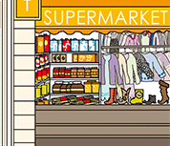
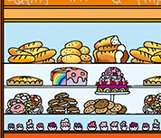
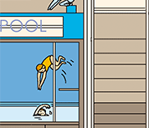
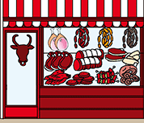
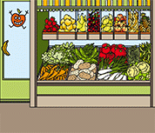
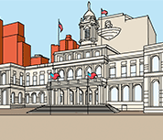
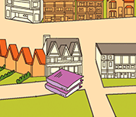
What’s missing ?

Slide 4
What’s missing ?

Slide 5
What’s missing ?

Slide 6
What’s missing ?

Slide 7
What’s missing ?

Slide 8
What’s missing ?

Slide 9
What’s missing ?

Slide 10
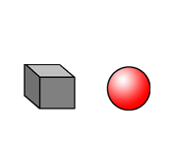
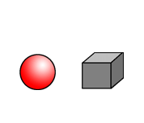
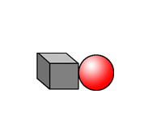
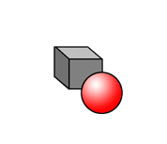
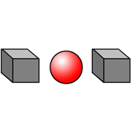
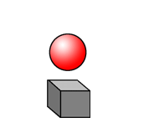
Listen and repeat

Slide 11
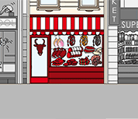
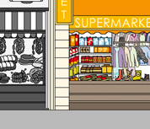
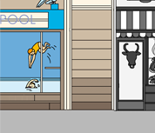
Listen and click on the right picture.
1/5

Slide 12
Listen and click on the right picture.
2/5

Slide 13
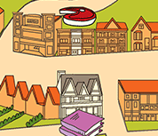
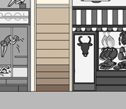
Listen and click on the right picture.
3/5

Slide 14
Listen and click on the right picture.
4/5

Slide 15
Listen and click on the right picture.
5/5

Slide 16
Look, listen and describe.

Slide 17
Look, listen and focus on what you understand.
Lucy: “Where’s the butcher’s?”
Lucy’s mother: “The butcher’s is between the swimming pool and the supermarket.”
Lucy: “Ok, I see. Let’s go!”
Lucy: “Excuse me? Where’s the butcher’s please?”
Man: “You go straight on and you turn to the left. It’s next to the swimming pool,
in front of the library.”
Lucy: “Ok, thank you very much!”
Lucy: “Here we are! This is the butcher’s store!”

Slide 18
Listen and click on the right picture.
1/5

Slide 19
Listen and click on the right picture.
2/5

Slide 20
Listen and click on the right picture.
3/5

Slide 21
Listen and click on the right picture.
4/5

Slide 22
Listen and click on the right picture.
5/5

Slide 23
Listen and click on the right picture.

Slide 24
What have we learned ?
- Where is the supermarket ?
Où est le supermarché ?
- The supermarket is on the right of the butchers.
Le supermarché est à la droite du boucher.
on the left of / next to / in front of
à la gauche de / à côté de / en face de
- Where is the butcher’s ?
Où est le boucher ?
- The butcher’s is between the swiming pool and the supermarket.
Le boucher est entre la piscine et le supermarché.

