Slide 1
NIVEAU 2
3- My town
3.1- Wich way ?
Step 2

Slide 2
Tongue Twister
Give Papa a cup of proper coffee in a copper coffee cup.

Slide 3
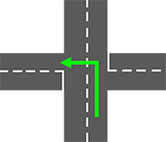
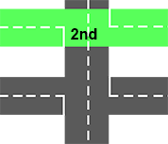
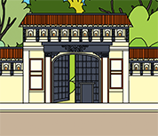
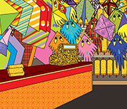
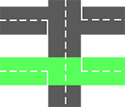
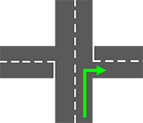
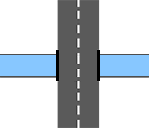
What’s missing ?

Slide 4
What’s missing ?

Slide 5
What’s missing ?

Slide 6
What’s missing ?

Slide 7
What’s missing ?

Slide 8
What’s missing ?

Slide 9
What’s missing ?

Slide 10
What’s missing ?

Slide 11
What’s missing ?

Slide 12
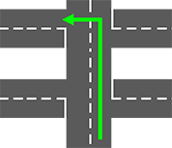
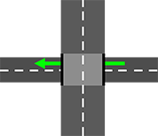
Listen and click on the right picture.
1/6

Slide 13
Listen and click on the right picture.
2/6

Slide 14
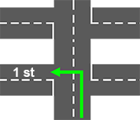
Listen and click on the right picture.
3/6

Slide 15
Listen and click on the right picture.
4/6

Slide 16
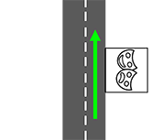
Listen and click on the right picture.
5/6

Slide 17
Listen and click on the right picture.
6/6

Slide 18
Look, listen and focus on what you understand.

Slide 19
Look, listen and focus on what you understand.
Lucy’s mother: “All right, so we’re going to the Calico Textile Museum
and we’ll meet later.”
Lucy’s father: “Ok! Enjoy! See you later!”
Tom: “Where is the museum? Do you have a map?”
Lucy: “No! We’ll have to ask someone!”
Lucy: “Hi! Excuse me madam, do you know where the Calico Textile Museum is?”
Woman: “Yes, sure. Go straight ahead, turn to the left, turn to the right,
then pass the road and go under the bridge!”
Lucy: “Ummm... Ok, thank you!”
Lucy: “Ummmm, I think we are lost now...”
Tom: “No, look ! There it is!

Slide 20
Listen and click on the right picture.
Turn left
Turn right
Second on the left
1/7

Slide 21
Listen and click on the right picture.
Second on the left
Pass the theater
First on the left
2/7

Slide 22
Listen and click on the right picture.
First on the left
Second on the left
Pass the theater
3/7

Slide 23
Listen and click on the right picture.
Pass the theater
Go under the bridge
Turn right
4/7

Slide 24
Listen and click on the right picture.
Pass the theater
Go straight ahead
Go under the bridge
5/7

Slide 25
Listen and click on the right picture.
Go straight ahead
Second on the left
Turn right
6/7

Slide 26
Listen and click on the right picture.
Go under the bridge
Go straight ahead
Second on the left
7/7

Slide 27
Listen and click on the right picture.
1/3

Slide 28
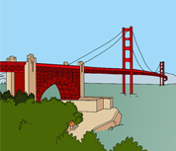
Listen and click on the right picture.
2/3

Slide 29
Listen and click on the right picture.
3/3

Slide 30
What have we learned ?
Excuse me, where is the museum, please ?
Excusez-moi, où est le musée, s’il-vous-plaît ?
Turn left.
Tournez à gauche.
Go under the bridge.
Passez sous le pont.
Excuse me, where is the kite shop, please ?
Excusez-moi, où est le magasin de cerfs-volants, s’il-vous-plaît ?
Go straight ahead, first on the left, turn right, go under the bridge, second on the left.
Tout droit, première à gauche, tournez à droite, passez sous le pont et deuxième à gauche.

