Slide 1
3- My town
3.1- At the grocer’s
Step 2

Slide 2
Tongue Twister
Pat-a-cake, pat-a-cake baker’s man Bake me a cake as fast as you can Pat it and prick it and mark it with “b” And put it in the oven for Baby and me.

Slide 3
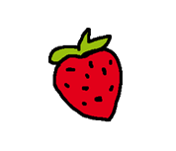
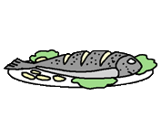
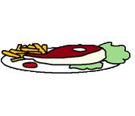
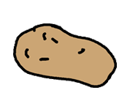
What’s missing ?

Slide 4
What’s missing ?

Slide 5
What’s missing ?

Slide 6
What’s missing ?

Slide 7
What’s missing ?

Slide 8
What’s missing ?

Slide 9
What’s missing ?

Slide 10
What’s missing ?

Slide 11
What’s missing ?

Slide 12
What’s missing ?

Slide 13
What’s missing ?

Slide 14
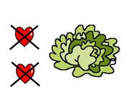
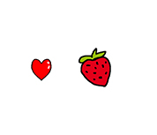
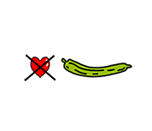
Listen and click on the right picture.
1/4

Slide 15
Listen and click on the right picture.
2/4

Slide 16
Listen and click on the right picture.
3/4

Slide 17
Listen and click on the right picture.
4/4

Slide 18
Look, listen and describe.

Slide 19
Look, listen and focus on what you understand.
Lucy’s mother: “Hey children, what would you like for dinner?”
Lucy: “I’d like some fish!”
Lucy’s mother: “Do you like fish Tom?”
Tom: “No, I don’t like fish. I prefer meat.”
Lucy’s mother: “Would you like a pizza? with a salad?”
Tom: “Yes, I love pizzas!”
Lucy: “Great! I like it too!”
Lucy’s mother: “All right... So... I need 5 tomatoes, a cucumber, some carrots and a lettuce.
I need ham as well. Can you go to the butcher’s for me? I’m going to join you
soon.”
Lucy: “Yes, sure!”
Tom: “Ok!”

Slide 20
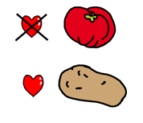
Listen and click on the right picture.
1/5

Slide 21
Listen and click on the right picture.
2/5

Slide 22
Listen and click on the right picture.
3/5

Slide 23
Listen and click on the right picture.
1/5

Slide 24
Listen and click on the right picture.
5/5

Slide 25
Listen and click on the right picture.
1/5

Slide 26
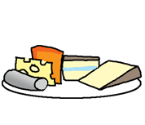
Listen and click on the right picture.
2/5

Slide 27
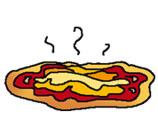
Listen and click on the right picture.
3/5

Slide 28
Listen and click on the right picture.
4/5

Slide 29
Listen and click on the right picture.
5/5

Slide 30
What have we learned ?
Do you like peaches ?
Aimes-tu les pêches ?
Yes, I do. (Oui)
No, I don’t. (Non)
No, I don’t like peaches, I prefer strawberries.
(Non, je n’aime pas les pêches, je préfère les fraises.)
No, I hate peaches.
(Non, je déteste les pêches.)
What would you like for lunch ? → I’d like a pizza.
Qu’aimerais-tu pour le déjeuner ? → J’aimerais une pizza.

