Slide 1
3- My town
3. 1- At the grocer’s
Step 1

Slide 2
Tongue Twister

Slide 3
Listen and repeat

Slide 4
What’s missing ?

Slide 5
What’s missing ?

Slide 6
What’s missing ?

Slide 7
What’s missing ?

Slide 8
What’s missing ?

Slide 9
What’s missing ?

Slide 10
What’s missing ?

Slide 11
What’s missing ?

Slide 12
What’s missing ?

Slide 13
What’s missing ?

Slide 14
What’s missing ?

Slide 15
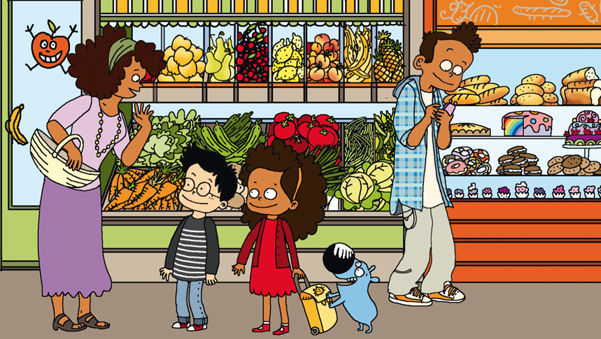
Look and say what you can.

Slide 16
Look, listen and describe.

Slide 17
What’s missing ?

Slide 18
What’s missing ?

Slide 19
What’s missing ?

Slide 20
What’s missing ?

Slide 21
What’s missing ?

Slide 22
What’s missing ?

Slide 23
What’s missing ?

Slide 24
What’s missing ?

Slide 25
What’s missing ?

Slide 26
What’s missing ?

Slide 27
What’s missing ?

Slide 28
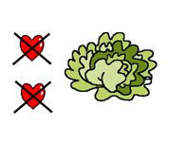
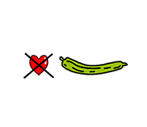
Listen and click on the right picture.
1/4

Slide 29
Listen and click on the right picture.
2/4

Slide 30
Listen and click on the right picture.
3/4

Slide 31
Listen and click on the right picture.
4/4

Slide 32
What have we learned ?
fish
a tomato
a cherry
meat
a cucumber
a peach
a potato
a carrot
a lemon
a lettuce
a strawberry

