Slide 1
3- My town
3. 2- A tour in my town
Step 1

Slide 2
Tongue Twister

Slide 3
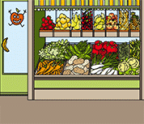
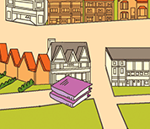
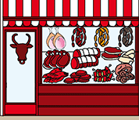
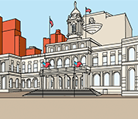
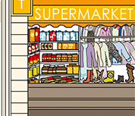
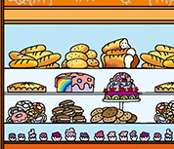
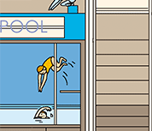
Listen and repeat

Slide 4
What’s missing ?

Slide 5
What’s missing ?

Slide 6
What’s missing ?

Slide 7
What’s missing ?

Slide 8
What’s missing ?

Slide 9
What’s missing ?

Slide 10
What’s missing ?

Slide 11
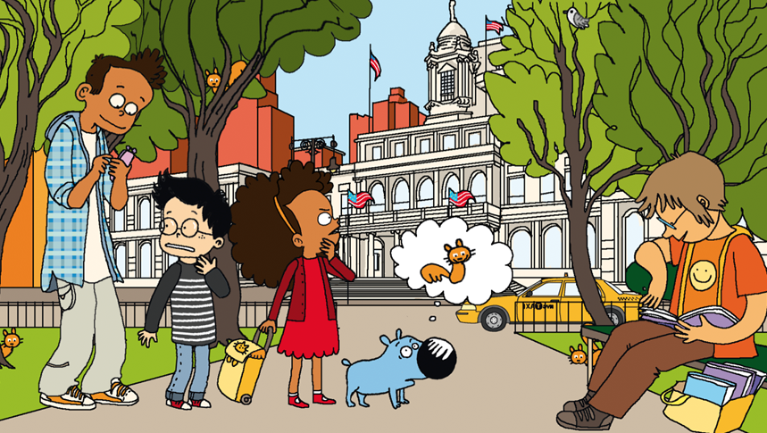
Look and say what you can.

Slide 12
Look, listen and describe.

Slide 13
What’s missing ?

Slide 14
What’s missing ?

Slide 15
What’s missing ?

Slide 16
What’s missing ?

Slide 17
What’s missing ?

Slide 18
What’s missing ?

Slide 19
What’s missing ?

Slide 20
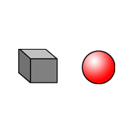
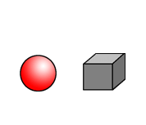
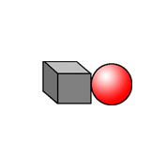
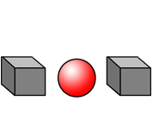
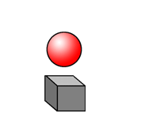
Listen and repeat

Slide 21
What have we learned ?
the grocers
a library
a supemarket
the butchers
the backers
a swimming pool
a city hall

