Slide 1
2- My school
2.4- I know my alphabet
Step 2

Slide 2
Tongue Twister
Not these things here but those things there.

Slide 4
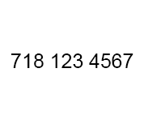
What’s missing ?

Slide 5
What’s missing ?

Slide 6
What’s missing ?

Slide 7
What’s missing ?

Slide 8
What’s missing ?

Slide 9
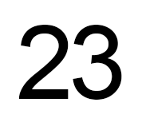
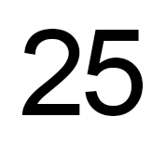
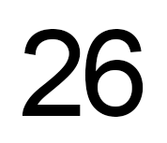
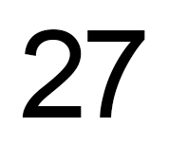
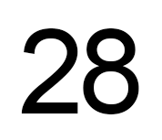
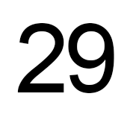
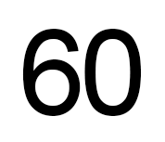
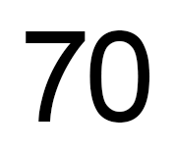
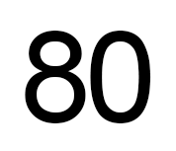
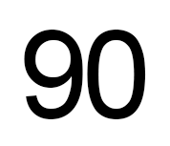
Listen and repeat

Slide 10
What’s missing ?

Slide 11
What’s missing ?

Slide 12
What’s missing ?

Slide 13
What’s missing ?

Slide 14
What’s missing ?

Slide 15
What’s missing ?

Slide 16
What’s missing ?

Slide 17
What’s missing ?

Slide 18
What’s missing ?

Slide 19
Look, listen and focus on what you understand.

Slide 20
Look, listen and focus on what you understand.
Teacher: “Hello children! Listen carefully. Take out your books please.
Open your book to page 32.”
Teacher: “Take out your glue.”
Tom: “I don’t have any glue. Do you have any glue for me please?”
Lucy: “Yes, I do. Here you are!”
Teacher: “Be quiet!“
Teacher: “Paul, sit down and give me your plane please”.
Teacher: “Page 32. Everybody reads the first paragraph in silence.”

Slide 21
Practise your dialogue.
What’s your name ? My name is …
Can you spell it, please ?
What’s your e-mail adress ? My e-mail adress is…
Can you spell it, please ? « at » pour @/ dot pour « . »
What’s your adress ? My adress is…
What’s your phone number ? My phone number is…

Slide 22
What have we learned ?
What’s your name ? My name is …
Can you spell it, please ?
What’s your e-mail adress ? My e-mail adress is…
Can you spell it, please ? « at » pour @/ dot pour « . »
What’s your adress ? My adress is…
What’s your phone number ? My phone number is…

