Slide 1
2- My school
2. 4- I know my alphabet !
Step 1

Slide 2
Tongue Twister

Slide 3
Listen and repeat

Slide 5
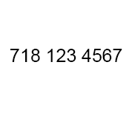
Listen and repeat

Slide 6
What’s missing ?

Slide 7
What’s missing ?

Slide 8
What’s missing ?

Slide 9
What’s missing ?

Slide 10
What’s missing ?

Slide 11
Look and say what you can.

Slide 12
Look, listen and describe.

Slide 13
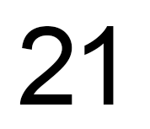
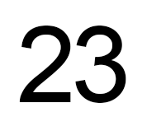
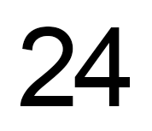
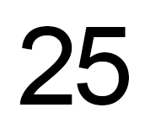
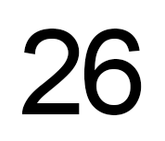
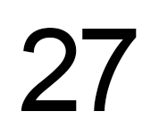
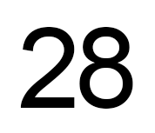
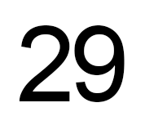
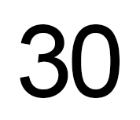
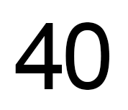
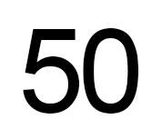
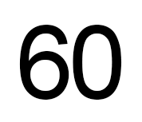
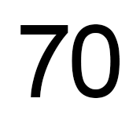
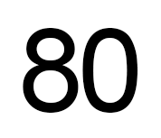
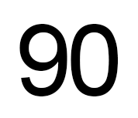
Listen and repeat

Slide 14
What’s missing ?

Slide 15
What’s missing ?

Slide 16
What’s missing ?

Slide 17
What’s missing ?

Slide 18
What’s missing ?

Slide 19
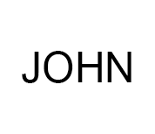
Listen and click on the right picture.
1/3

Slide 20
Listen and click on the right picture.
2/3

Slide 21
Listen and click on the right picture.
3/3

Slide 22
What have we learned ?
twenty
ninety
thirty
a hundred
forty
fifty
a phone number
sixty
an adress
seventy
eighty
an e-mail adress

