Slide 1
NIVEAU 2
2- My school
2.4- Can you spell it ?
Step 2

Slide 2
Tongue Twister
Freshly-fried flying fish

Slide 3
Can you spell it ?

Slide 4
Listen and click on the right picture.
1/5

Slide 5
Listen and click on the right picture.
2/5

Slide 6
Listen and click on the right picture.
3/5

Slide 7
Listen and click on the right picture.
4/5

Slide 8
Listen and click on the right picture.
5/5

Slide 9
Look, listen and focus on what you understand.

Slide 10
Look, listen and focus on what you understand.
Thando: “I’d like to see more about your school. Can you send us some pictures?”
Tom: “Yes, sure. What’s your email address?”
Thando: “My email address is thando73@myemail.com”
Tom: “Can you spell it please?”
Thando: “T.H.A.N.D.O.7.3.@myemail.com”
Lucy: “What’s your email address, Mbali?”
Mbali: “Mbalilittleflower24@myemail.com”
Lucy: “How many letters in your name? Can you spell it please?”
Mbali: “Yes. In Mbali, there are 5 letters... it’s M B A L I.”
Lucy: “Ok, perfect! Thank you!

Slide 11
Listen and click on the right picture.
1/3

Slide 12
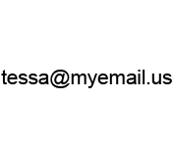
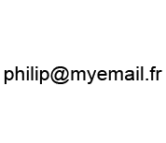
Listen and click on the right picture.
2/3

Slide 13
Listen and click on the right picture.
3/3

Slide 14
Practise your dialogue ?
- What’s your e-mail address ?
My e-mail address is…
Can you spell it, please ?
…

Slide 15
What have we learned ?
B.I.G
C.A.T
D.O.G
B.E.D
T.A.B.L.E
F.R.A.N.C.E
P.A.R.I.S
K.I.T.C.H.E.N
S.C.H.O.O.L.B.A.G
N.E.W – Y.O.R.K
P.E.N.C.I.L
M.U.M.M.Y
S.O.U.T.H – A.F.R.I.C.A

