Slide 1
NIVEAU 2
2- My school
2.4- Can you spell it ?
Step 1

Slide 2
Tongue Twister

Slide 3
Listen and repeat

Slide 4
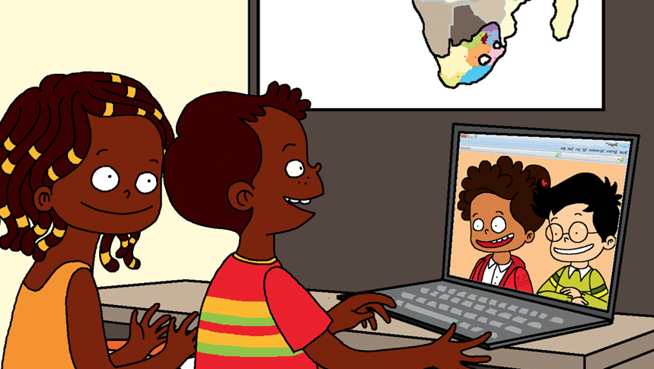
Look and say what you can.

Slide 5
Look, listen and describe.

Slide 6
Listen and repeat

Slide 7
What’s missing ?

Slide 8
What’s missing ?

Slide 9
What’s missing ?

Slide 10
What’s missing ?

Slide 11
What’s missing ?

Slide 12
What’s missing ?

Slide 13
What’s missing ?

Slide 14
Listen and click on the right picture.
1/6

Slide 15
Listen and click on the right picture.
2/6

Slide 16
Listen and click on the right picture.
3/6

Slide 17
Listen and click on the right picture.
4/6

Slide 18
Listen and click on the right picture.
5/6

Slide 19
Listen and click on the right picture.
6/6

Slide 20
What have we learned ?
Can you spell…
… America ? : A-M-E-R-I-C-A
… France ? : F-R-A-N-C-E
… New York ? : N-E-W-Y-O-R-K

