Slide 1
NIVEAU 2
2- My school
2.3- In my school bag
Step 1

Slide 2
Tongue Twister

Slide 3
Listen and repeat

Slide 4
What’s missing ?

Slide 5
What’s missing ?

Slide 6
What’s missing ?

Slide 7
What’s missing ?

Slide 8
What’s missing ?

Slide 9
What’s missing ?

Slide 10
What’s missing ?

Slide 11
What’s missing ?

Slide 12
What’s missing ?

Slide 13
What’s missing ?

Slide 14
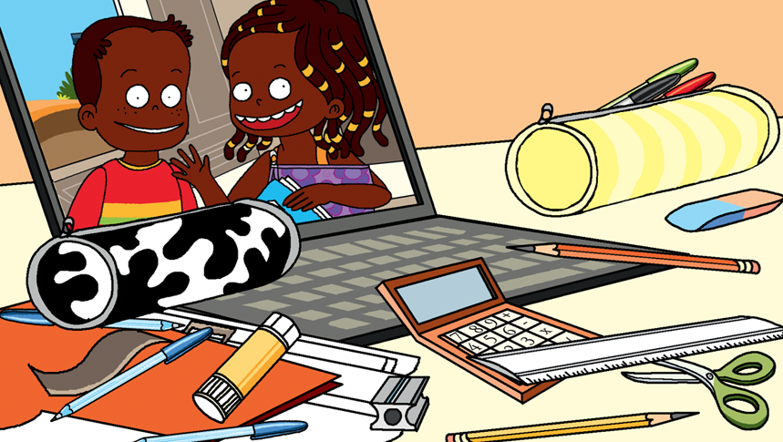
Look and say what you can.

Slide 15
Look, listen and describe.

Slide 16
What’s missing ?

Slide 17
What’s missing ?

Slide 18
What’s missing ?

Slide 19
What’s missing ?

Slide 20
What’s missing ?

Slide 21
What’s missing ?

Slide 22
What’s missing ?

Slide 23
What’s missing ?

Slide 24
What’s missing ?

Slide 25
What’s missing ?

Slide 26
Listen and click on the right picture.
1/5

Slide 27
Listen and click on the right picture.
2/5

Slide 28
Listen and click on the right picture.
3/5

Slide 29
Listen and click on the right picture.
4/5

Slide 30
Listen and click on the right picture.
5/5

Slide 31
What have we learned ?
a schoolbag
a big calculator
an orange folder
a blue notebook
a pencil sharpener
a black and white pencil case
an agenda
two blue pens
a yellow highlighter
a USB flashdrive

