Slide 1
2- My school
2.3- in my school
Step 2

Slide 2
Tongue Twister
Not these things here but those things there.

Slide 3
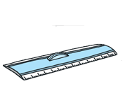
What’s missing ?

Slide 4
What’s missing ?

Slide 5
What’s missing ?

Slide 6
What’s missing ?

Slide 7
What’s missing ?

Slide 8
What’s missing ?

Slide 9
What’s missing ?

Slide 10
What’s missing ?

Slide 11
What’s missing ?

Slide 12
Listen and click on the right picture.
1/6

Slide 13
Listen and click on the right picture.
2/6

Slide 14
Listen and click on the right picture.
3/6

Slide 15
Listen and click on the right picture.
4/6

Slide 16
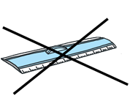
Listen and click on the right picture.
5/6

Slide 17
Listen and click on the right picture.
6/6

Slide 18
Look, listen and focus on what you understand.

Slide 19
Look, listen and focus on what you understand.
Teacher: “Hello children! Listen carefully. Take out your books please.
Open your book to page 32.”
Teacher: “Take out your glue.”
Tom: “I don’t have any glue. Do you have any glue for me please?”
Lucy: “Yes, I do. Here you are!”
Teacher: “Be quiet!“
Teacher: “Paul, sit down and give me your plane please”.
Teacher: “Page 32. Everybody reads the first paragraph in silence.”

Slide 20
Listen and click on the right picture.

Slide 21
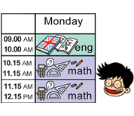
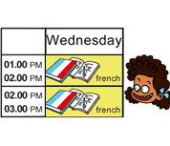
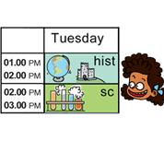
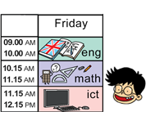
Listen and click on the right picture.

Slide 22
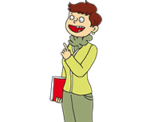
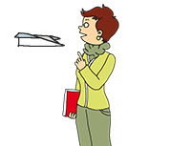
Listen and repeat

Slide 23
What have we learned ?
Give me your pen.
Show me your glue.
Take out your pencil.
Open your book to page 32.
Stand up !
Sit down !
Be quiet !
Listen carefully !

