Slide 1
2- My school
2. 3- in my school
Step 1

Slide 2
Tongue Twister

Slide 3
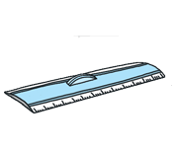
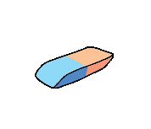
Listen and repeat

Slide 4
What’s missing ?

Slide 5
What’s missing ?

Slide 6
What’s missing ?

Slide 7
What’s missing ?

Slide 8
What’s missing ?

Slide 9
What’s missing ?

Slide 10
What’s missing ?

Slide 11
What’s missing ?

Slide 12
What’s missing ?

Slide 13
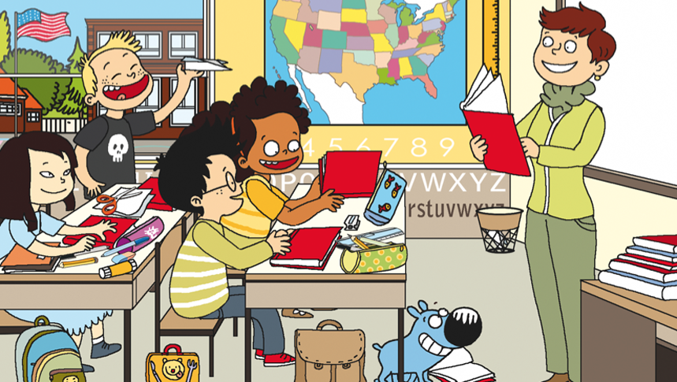
Look and say what you can.

Slide 14
Look, listen and describe.

Slide 15
What’s missing ?

Slide 16
What’s missing ?

Slide 17
What’s missing ?

Slide 18
What’s missing ?

Slide 19
What’s missing ?

Slide 20
What’s missing ?

Slide 21
What’s missing ?

Slide 22
What’s missing ?

Slide 23
What’s missing ?

Slide 24
Listen and click on the right picture.
1/6

Slide 25
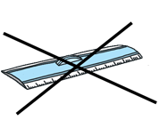
Listen and click on the right picture.
2/6

Slide 26
Listen and click on the right picture.
3/6

Slide 27
Listen and click on the right picture.
4/6

Slide 28
Listen and click on the right picture.
5/6

Slide 29
Listen and click on the right picture.
6/6

Slide 30
What have we learned ?
scissors
a schoolbag
a pencil sharpener
a pencil
glue
a ruler
a pen
a pencil case
an eraser
Do you have a/ an…? Yes, I do. No, I don't.

