Slide 1
2- My school
2.2- My schedule
Step 2

Slide 2
Tongue Twister
Are you sleeping, are you sleeping? Brother John, Brother John? Morning bells are ringing, morning bells are ringing Ding dang dong, ding dang dong.

Slide 3
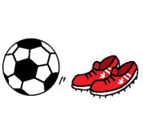
What’s missing ?

Slide 4
What’s missing ?

Slide 5
What’s missing ?

Slide 6
What’s missing ?

Slide 7
What’s missing ?

Slide 8
What’s missing ?

Slide 9
What’s missing ?

Slide 10
What’s missing ?

Slide 11
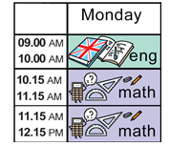
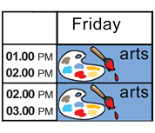
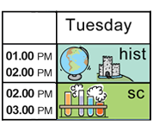
Listen and click on the right picture.
1/5

Slide 12
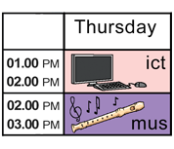
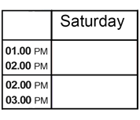
Listen and click on the right picture.
2/5

Slide 13
Listen and click on the right picture.
3/5

Slide 14
Listen and click on the right picture.
4/5

Slide 15
Listen and click on the right picture.
5/5

Slide 16
Look, listen and focus on what you understand.

Slide 17
Look, listen and focus on what you understand.
Lucy: “This is my schedule.” Tom: “What do you have on monday?” Lucy: “On Monday morning, I have french and math. On Monday afternoon, I have english and PE.” Tom: “Do you have french on Tuesday?” Lucy: “Ummm, no I don’t.” Tom: “Do you have ICT on Wednesday?” Lucy: “Yes, I do.” Tom: “Oh! She’s going to school now. What does she have today? Does she have arts on Monday?” Lucy: “Yes, she does!”

Slide 18
Listen and click on the right picture.

Slide 19
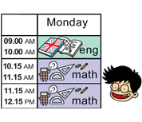
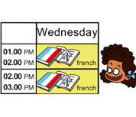
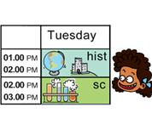
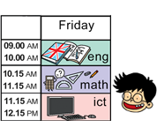
Listen and click on the right picture.

Slide 20
What have we learned ?
Do you have math on Monday morning ?
- Yes I do.
- No I don’t.
Does he have english on friday afternoon ?
- Yes he does.
- No he doesn’t.
Does she have french on thursday afternoon ?
- Yes she does.
- No she doesn’t.

