Slide 1
2- My school
2. 2- My schedule
Step 1

Slide 2
Tongue Twister

Slide 3
Listen and repeat

Slide 4
What’s missing ?

Slide 5
What’s missing ?

Slide 6
What’s missing ?

Slide 7
What’s missing ?

Slide 8
What’s missing ?

Slide 9
What’s missing ?

Slide 10
What’s missing ?

Slide 11
What’s missing ?

Slide 12
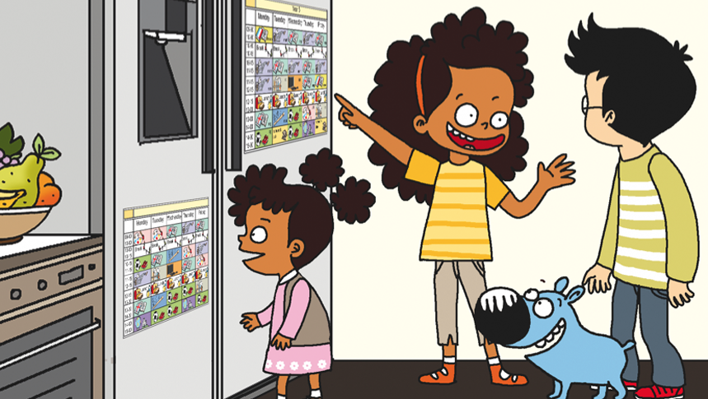
Look and say what you can.

Slide 13
Look, listen and describe.

Slide 14
What’s missing ?

Slide 15
What’s missing ?

Slide 16
What’s missing ?

Slide 17
What’s missing ?

Slide 18
What’s missing ?

Slide 19
What’s missing ?

Slide 20
What’s missing ?

Slide 21
What’s missing ?

Slide 22
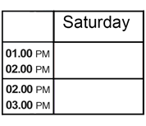
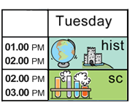
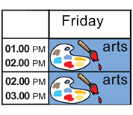
Listen and click on the right picture.
1/5

Slide 23
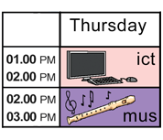
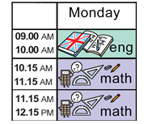
Listen and click on the right picture.
2/5

Slide 24
Listen and click on the right picture.
3/5

Slide 25
Listen and click on the right picture.
4/5

Slide 26
Listen and click on the right picture.
4/5

Slide 27
What have we learned ?
math
history
english
science
P.E
music
I.C.T
art
monday – tuesday – wednesday – thursday – friday – saturday – sunday

