Slide 1
NIVEAU 2
2- My school
2.2- At school
Step 2

Slide 2
Tongue Twister
Imagine an imaginary menagerie manager managing an imaginary menagerie

Slide 3
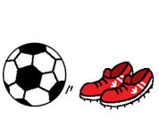
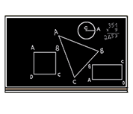
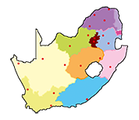
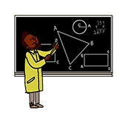
What’s missing ?

Slide 4
What’s missing ?

Slide 5
What’s missing ?

Slide 6
What’s missing ?

Slide 7
What’s missing ?

Slide 8
What’s missing ?

Slide 9
What’s missing ?

Slide 10
What’s missing ?

Slide 11
What’s missing ?

Slide 12
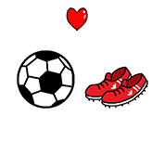
Listen and click on the right picture.
1/6

Slide 13
Listen and click on the right picture.
1/6

Slide 14
Listen and click on the right picture.
3/6

Slide 15
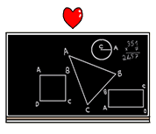
Listen and click on the right picture.
4/6

Slide 16
Listen and click on the right picture.
5/6

Slide 17
Listen and click on the right picture.
6/6

Slide 18
Look, listen and focus on what you understand.

Slide 19
Look, listen and focus on what you understand.
Tom: “Hello! How are you?”
Mbali: “Hello! I’m very well.”
Thando: “I’m fine! I love Fridays!”
Lucy: “What do you have on Friday?”
Thando: “On Friday morning, we have English and ICT. On Friday afternoon, we have art.”
Tom: “That’s nice! What’s your favourite subject?”
Thando: “Art. That’s why today, I’m very happy because I have art and I like it very much!
What about you Tom?”
Tom: “I love English because we read books and we write stories!”
Thando: “What are your favourite subjects Lucy?”
Lucy: “Maths and history. In maths, we work in pairs and we do exercises.
In history, we learn lessons about the Middle Ages... It’s fascinating!”

Slide 20
Listen and click on the right picture.
1/6

Slide 21
Listen and click on the right picture.
2/6

Slide 22
Listen and click on the right picture.
3/6

Slide 23
Listen and click on the right picture.
4/6

Slide 24
Listen and click on the right picture.
5/6

Slide 25
Listen and click on the right picture.
6/6

Slide 26
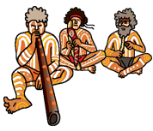
Listen and click on the right picture.
1/7

Slide 27
Listen and click on the right picture.
2/7

Slide 28
Listen and click on the right picture.
3/7

Slide 29
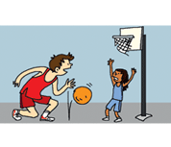
Listen and click on the right picture.
4/7

Slide 30
Listen and click on the right picture.
5/7

Slide 31
Listen and click on the right picture.
6/7

Slide 32
Listen and click on the right picture.
7/7

Slide 33
What have we learned ?
What do you do in geography ?
I study maps.
What do you do in history ?
I learn about middle ages.
What do you do in math ?
I do exercises.
Do you like writing ?
No, I don’t.
Do you like reading ?
Yes, I do.

