Slide 1
NIVEAU 2
2- My school
2.2- At school
Step 1

Slide 2
Tongue Twister

Slide 3
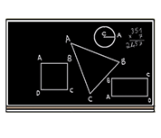
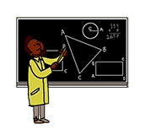
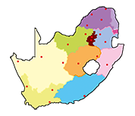
Listen and repeat

Slide 4
What’s missing ?

Slide 5
What’s missing ?

Slide 6
What’s missing ?

Slide 7
What’s missing ?

Slide 8
What’s missing ?

Slide 9
What’s missing ?

Slide 10
What’s missing ?

Slide 11
What’s missing ?

Slide 12
What’s missing ?

Slide 13
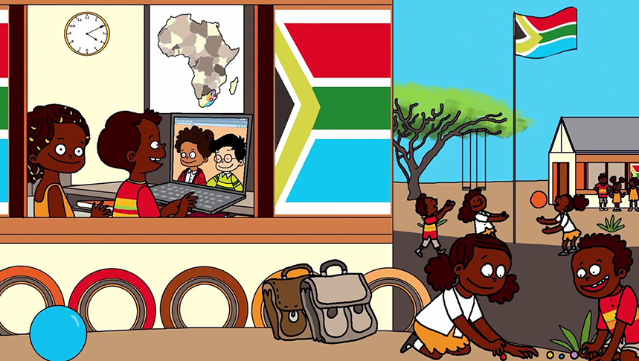
Look and say what you can.

Slide 14
Look, listen and describe.

Slide 15
What’s missing ?

Slide 16
What’s missing ?

Slide 17
What’s missing ?

Slide 18
What’s missing ?

Slide 19
What’s missing ?

Slide 20
What’s missing ?

Slide 21
What’s missing ?

Slide 22
What’s missing ?

Slide 23
What’s missing ?

Slide 24
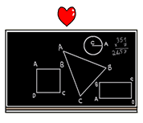
Listen and click on the right picture.
1/6

Slide 25
Listen and click on the right picture.
2/6

Slide 26
Listen and click on the right picture.
3/6

Slide 27
Listen and click on the right picture.
4/6

Slide 28
Listen and click on the right picture.
5/6

Slide 29
Listen and click on the right picture.
6/6

Slide 30
What have we learned ?
maths
an exercise
english
a lesson
art
P.E
writing
a map
reading

