Slide 1
NIVEAU 2
2- My school
2.1- How do you feel ?
Step 2

Slide 2
Tongue Twister
World wide web

Slide 3
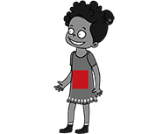
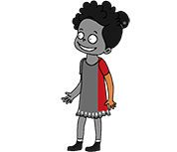
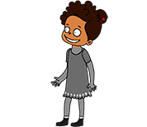
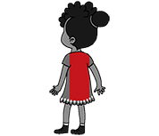
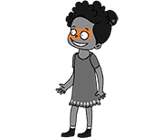
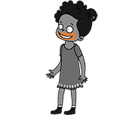
What’s missing ?

Slide 4
What’s missing ?

Slide 5
What’s missing ?

Slide 6
What’s missing ?

Slide 7
What’s missing ?

Slide 8
What’s missing ?

Slide 9
What’s missing ?

Slide 10
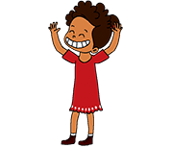
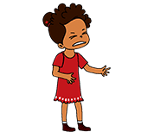
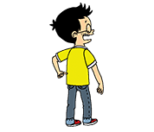
Listen and click on the right picture.
1/5

Slide 11
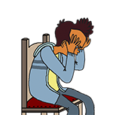
Listen and click on the right picture.
2/5

Slide 12
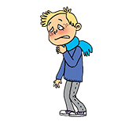
Listen and click on the right picture.
3/5

Slide 13
Listen and click on the right picture.
4/5

Slide 14
Listen and click on the right picture.
5/5

Slide 15
Look, listen and focus on what you understand.

Slide 16
Look, listen and focus on what you understand.
Tom: “Hello Paul! How are you today?”
Paul: “Hi! I’m sad because holidays are over... and moreover, I have a sore throat.
I’m very tired... What about you?”
Tom: “I’m very well. I’m super excited about today!”
Paul: “How are you today Lucy?”
Lucy: “I’m extremely happy to meet our pen-friends again.”
Paul: “Yes, that’s great! And how is Bingo this morning? He doesn’t look good!”
Tom: “No, he’s not! This morning, he’s very sick!”

Slide 17
What’s missing ?

Slide 18
What’s missing ?

Slide 19
What’s missing ?

Slide 20
What’s missing ?

Slide 21
What’s missing ?

Slide 22
What’s missing ?

Slide 23
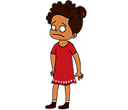
Listen and click on the right picture.
1/4

Slide 24
Listen and click on the right picture.
2/4

Slide 25
Listen and click on the right picture.
3/4

Slide 26
Listen and click on the right picture.
4/4

Slide 27
What have we learned ?
Does she have a sore throat ?
No, she doesn’t. She has a stomachache.
Does he have a headache?
Yes, he does.
Does he have a backache?
Yes, he does.
a backache
happy
a headache
a stomachache
a sore throat

