Slide 1
2- My school
2.1- Are you ok ?
Step 2

Slide 2
Tongue Twister
Are you sleeping, are you sleeping? Brother John, Brother John? Morning bells are ringing, morning bells are ringing Ding dang dong, ding dang dong.

Slide 3
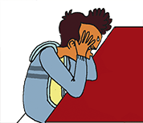
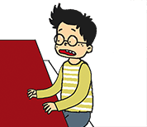
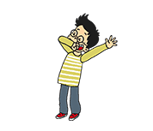
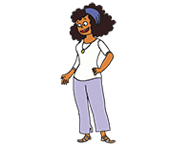
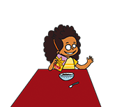
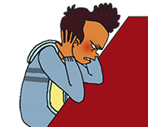
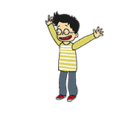
What’s missing ?

Slide 4
What’s missing ?

Slide 5
What’s missing ?

Slide 6
What’s missing ?

Slide 7
What’s missing ?

Slide 8
What’s missing ?

Slide 9
What’s missing ?

Slide 10
Listen and click on the right picture.
1/7

Slide 11
Listen and click on the right picture.
2/7

Slide 12
Listen and click on the right picture.
3/7

Slide 13
Listen and click on the right picture.
4/7

Slide 14
Listen and click on the right picture.
5/7

Slide 15
Listen and click on the right picture.
6/7

Slide 16
Listen and click on the right picture.
7/7

Slide 17
Look, listen and focus on what you understand.

Slide 18
Look, listen and focus on what you understand.
Tom: “Hello Lucy! How are you today?”
Lucy: “I’m very well! I’m happy to go to school with you! How are you Tom?”
Tom: “I’m tired but I’m ok!”
Tom: “How is he today? He doesn’t look good!”
Lucy: “No! He’s not! His head hurts!”
Lucy’s mother: “Hi! How are you?”
Tom: “I’m ok.”
Lucy: “I’m very well! What about you mummy?”
Lucy’s mother: “I’m fine!”

Slide 19
Listen and click on the right picture.

Slide 20
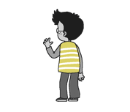
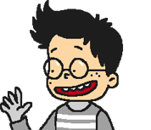
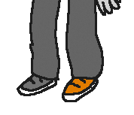
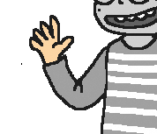
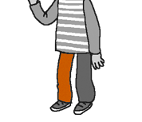
Listen and repeat

Slide 21
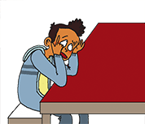
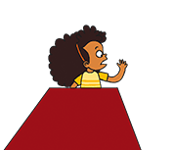
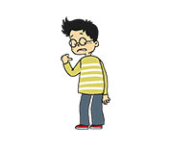
Listen and click on the right picture.

Slide 22
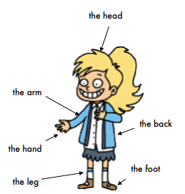
What have we learned ?
How are you today ?
Today, I’m…
How is he today ?
Today, he is…
How is she today ?
Today, she is…
My
His back hurts.
Her

