Slide 1
2- My school
2. 1- Are you ok ?
Step 1

Slide 2
Tongue Twister

Slide 3
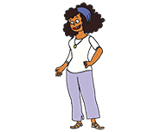
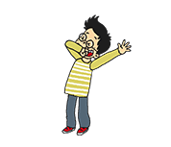
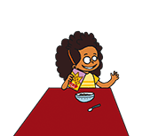
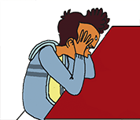
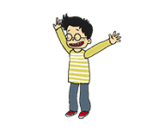
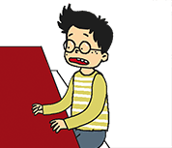
Listen and repeat

Slide 4
What’s missing ?

Slide 5
What’s missing ?

Slide 6
What’s missing ?

Slide 7
What’s missing ?

Slide 8
What’s missing ?

Slide 9
What’s missing ?

Slide 10
What’s missing ?

Slide 11
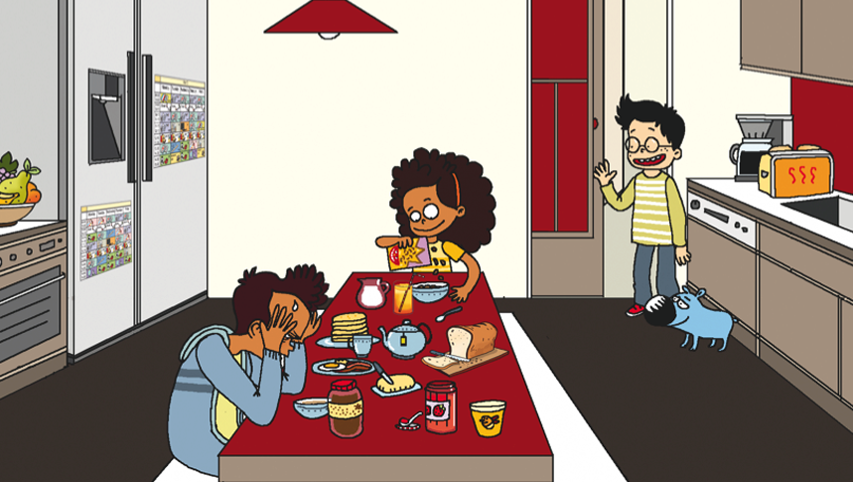
Look and say what you can.

Slide 12
Look, listen and describe.

Slide 13
What’s missing ?

Slide 14
What’s missing ?

Slide 15
What’s missing ?

Slide 16
What’s missing ?

Slide 17
What’s missing ?

Slide 18
What’s missing ?

Slide 19
What’s missing ?

Slide 20
Listen and click on the right picture.
1/4

Slide 21
Listen and click on the right picture.
2/4

Slide 22
Listen and click on the right picture.
3/4

Slide 23
Listen and click on the right picture.
4/4

Slide 24
What have we learned ?
fine
tired
happy
not very well
ok
upset
sad

