Slide 1
NIVEAU 2
1- My Home
1.5- San Francisco
Step 1

Slide 2
Tongue Twister

Slide 3
Look and say what you can.

Slide 4
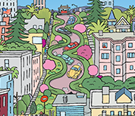
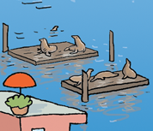
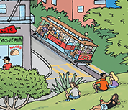
Listen and repeat

Slide 5
What’s missing ?

Slide 6
What’s missing ?

Slide 7
What’s missing ?

Slide 8
What’s missing ?

Slide 9
What’s missing ?

Slide 10
Look, listen and describe.

Slide 11
What’s missing ?

Slide 12
What’s missing ?

Slide 13
What’s missing ?

Slide 14
What’s missing ?

Slide 15
What’s missing ?

Slide 16
What have we learned ?
the Golden Gate
the Transamerica pyramid
Lombard street
the cable car
the piers

