Slide 1
1- My Home
5 – History of America
Step 1

Slide 2
Tongue Twister

Slide 3
Look and say what you can.

Slide 4
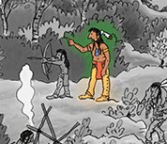
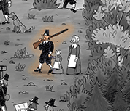
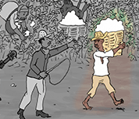
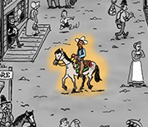
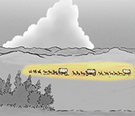
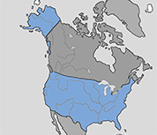
Listen and repeat

Slide 5
What’s missing ?

Slide 6
What’s missing ?

Slide 7
What’s missing ?

Slide 8
What’s missing ?

Slide 9
What’s missing ?

Slide 10
What’s missing ?

Slide 11
What’s missing ?

Slide 12
Look, listen and describe.

Slide 13
What’s missing ?

Slide 14
What’s missing ?

Slide 15
What’s missing ?

Slide 16
What’s missing ?

Slide 17
What’s missing ?

Slide 18
What’s missing ?

Slide 19
What’s missing ?

Slide 20
What have we learned ?
an indian
settlers
a pilgrim
the United states of America (USA)
a slave
the American flag
a cow boy

