Slide 1
NIVEAU 2
1- My Home
1.1- Describing someone
Step 2

Slide 2
Tongue Twister
Her hair hangs high above her head

Slide 3
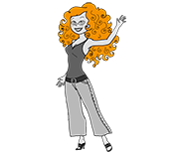
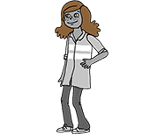
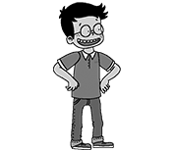
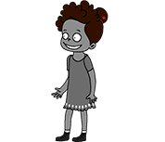
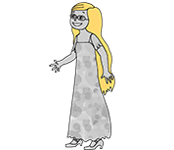
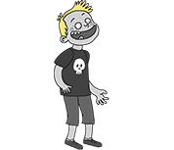
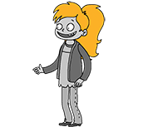
What’s missing ?

Slide 4
What’s missing ?

Slide 5
What’s missing ?

Slide 6
What’s missing ?

Slide 7
What’s missing ?

Slide 8
What’s missing ?

Slide 9
What’s missing ?

Slide 10
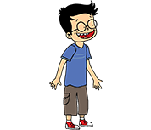
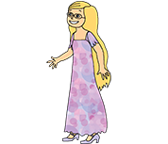
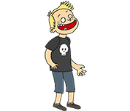
Listen and click on the right picture.
1/6

Slide 11
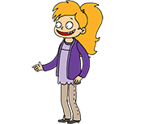
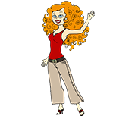
Listen and click on the right picture.
2/6

Slide 12
Listen and click on the right picture.
3/6

Slide 13
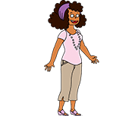
Listen and click on the right picture.
4/6

Slide 14
Listen and click on the right picture.
5/6

Slide 15
Listen and click on the right picture.
6/6

Slide 16
Look, listen and focus on what you understand.

Slide 17
Look, listen and focus on what you understand.
Lucy’s aunt: “Hi! I’m so glad to see you! How are you?”
Tom: “Hello!”
Lucy: “Hi!”
Lucy’s mother: “Good morning! We’re great!”
Lucy’s aunt: “Do you want a cup of tea?”
Lucy’s mother: “Yes please... Oh! I love your dress! You look good!”
Lucy’s aunt: “Oh ! Thank you!”
Tom: “Oh! Who is she? She looks nice!”
Lucy: “Yes, she is! This is Amy. She has beautiful curly hair and freckles.
She’s very pretty!”

Slide 18
What’s missing ?

Slide 19
What’s missing ?

Slide 20
What’s missing ?

Slide 21
What’s missing ?

Slide 22
What’s missing ?

Slide 23
What’s missing ?

Slide 24
What’s missing ?

Slide 25
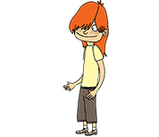
Listen and click on the right picture.
1/6

Slide 26
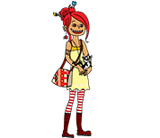
Listen and click on the right picture.
2/6

Slide 27
Listen and click on the right picture.
3/6

Slide 28
Listen and click on the right picture.
4/6

Slide 29
Listen and click on the right picture.
5/6

Slide 30
Listen and click on the right picture.
6/6

Slide 31
What have we learned ?
Does she have a pony tail ?
Yes, she does.
Does she have curly hair?
Yes, she does.
Does she have black hair ?
No, she doesn’t. she has red hair.

