Slide 1
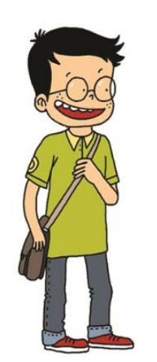
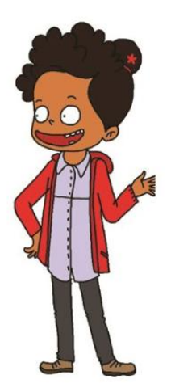
NIVEAU 2
1- My Home
1.1- Describing someone
Step 1

Slide 2
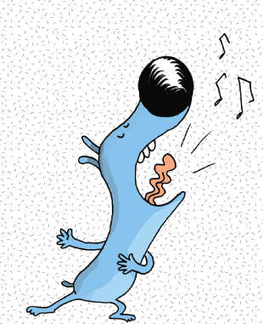
Tongue Twister

Slide 3
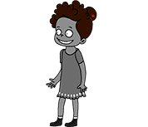
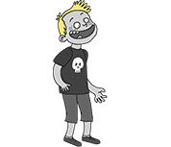
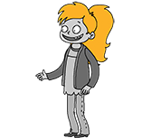
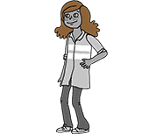
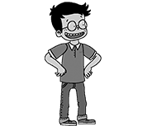
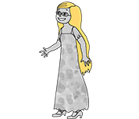
Listen and repeat

Slide 4
What’s missing ?

Slide 5
What’s missing ?

Slide 6
What’s missing ?

Slide 7
What’s missing ?

Slide 8
What’s missing ?

Slide 9
What’s missing ?

Slide 10
What’s missing ?

Slide 11
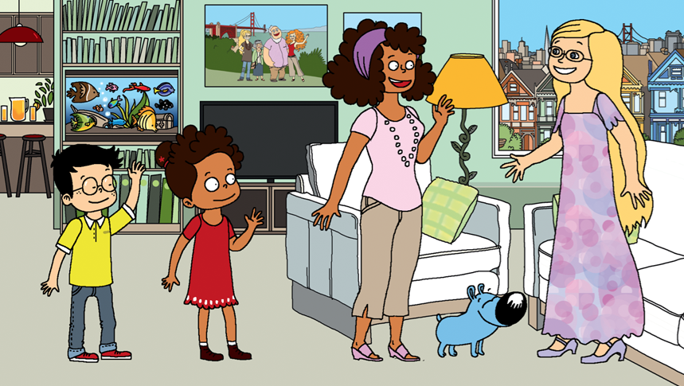
Look and say what you can.

Slide 12
What’s missing ?

Slide 13
What’s missing ?

Slide 14
What’s missing ?

Slide 15
What’s missing ?

Slide 16
What’s missing ?

Slide 17
What’s missing ?

Slide 18
What’s missing ?

Slide 19
What have we learned ?
black hair
long hair
blond hair
curly hair
short black hair
a ponytail
long blond hair

