Slide 1
1- My Home
4 - My House
Step 2

Slide 2
Tongue Twister
Round and round the rugged rock the ragged rascal ran.

Slide 3
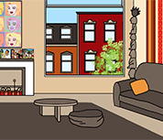
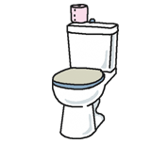
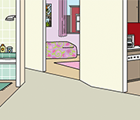
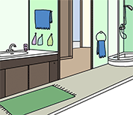
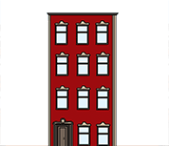
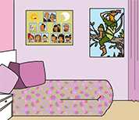
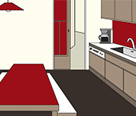
What’s missing ?

Slide 4
What’s missing ?

Slide 5
What’s missing ?

Slide 6
What’s missing ?

Slide 7
What’s missing ?

Slide 8
What’s missing ?

Slide 9
What’s missing ?

Slide 10
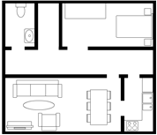
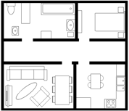
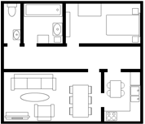
Listen and click on the right picture.
1/3

Slide 11
Listen and click on the right picture.
2/3

Slide 12
Listen and click on the right picture.
3/3

Slide 13
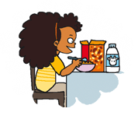
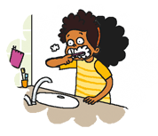
Listen and repeat

Slide 14
What’s missing ?

Slide 15
What’s missing ?

Slide 16
What’s missing ?

Slide 17
What’s missing ?

Slide 18
Look, listen and focus on what you understand.

Slide 19
Look, listen and focus on what you understand.
Lucy: “Come with me! I’m going to show you my bedroom!”
Tom: “How many rooms are there in your flat?”
Lucy: “There are 9 rooms in my appartment: a living room, a kitchen, 5 bedrooms, a bathroom and a toilet.”
Tom: “Oh! It’s huge!”
Lucy: “This is the kitchen... and over there, there are the bathroom and the toilets.”
Tom: “It’s really nice!”
Lucy: “Tomorrow morning, we’re going to my school.”
Tom: “Great! I can’t wait for it! What do you do in the morning?”
Lucy: “Ummmm. I wake up, I have breakfast, I brush my teeth and I go to school.”

Slide 20
Listen and click on the right picture.

Slide 21
What’s missing ?

Slide 22
What’s missing ?

Slide 23
What’s missing ?

Slide 24
What’s missing ?

Slide 25
What have we learned ?
- How many rooms are there in your apartment / house ?
- There are … rooms in my apartment / house.
What do you do in the morning ?
I wake up.
I brush my teeth.
I have breakfast.
I go to school.

