Slide 1
NIVEAU 2
1- My Home
4 - House
Step 2

Slide 2
Tongue Twister
The beautiful big blue balloon bursts.

Slide 3
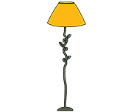
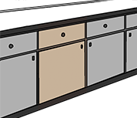
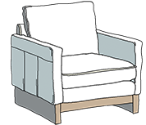
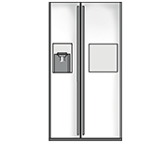
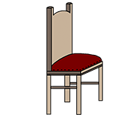
What’s missing ?

Slide 4
What’s missing ?

Slide 5
What’s missing ?

Slide 6
What’s missing ?

Slide 7
What’s missing ?

Slide 8
What’s missing ?

Slide 9
What’s missing ?

Slide 10
What’s missing ?

Slide 11
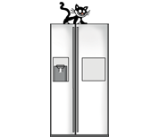
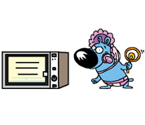
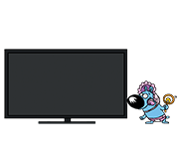
Listen and click on the right picture.
1/8

Slide 12
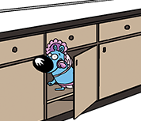
Listen and click on the right picture.
2/8

Slide 13
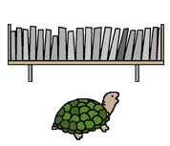
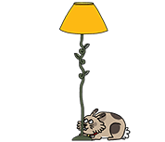
Listen and click on the right picture.
3/8

Slide 14
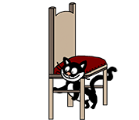
Listen and click on the right picture.
4/8

Slide 15
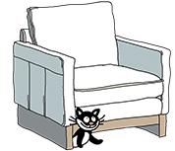
Listen and click on the right picture.
5/8

Slide 16
Listen and click on the right picture.
6/8

Slide 17
Listen and click on the right picture.
7/8

Slide 18
Listen and click on the right picture.
8/8

Slide 19
Look, listen and focus on what you understand.

Slide 20
Look, listen and focus on what you understand.
Lucy: “ Where’s your kitten ? ”
Tessa: “ I don’t know. Maybe in the kitchen, next to the fridge ? ”
Lucy: “ Ummm. Where’s Tessa’s cat ?
Tom: “ He’s not in the cupboard.”
Lucy: “ He’s not behind the fridge!”
Tessa: “ There he is!”
Tessa: “ He’s on the armchair, under the blanket. I think he’s pretty comfortable!”
Lucy: “ Hahaha, Kittens are very clever ! ”

Slide 21
What’s missing ?

Slide 22
What’s missing ?

Slide 23
What’s missing ?

Slide 24
What’s missing ?

Slide 25
What’s missing ?

Slide 26
What’s missing ?

Slide 27
What’s missing ?

Slide 28
What’s missing ?

Slide 29
What’s missing ?

Slide 30
Listen and click on the right picture.
1/8

Slide 31
Listen and click on the right picture.
2/8

Slide 32
Listen and click on the right picture.
3/8

Slide 33
Listen and click on the right picture.
4/8

Slide 34
Listen and click on the right picture.
5/8

Slide 35
Listen and click on the right picture.
6/8

Slide 36
Listen and click on the right picture.
7/8

Slide 37
Listen and click on the right picture.
8/8

Slide 38
What have we learned ?
Where’s Tessa’s cat ?
Tessa’s cat is on the fridge.
Tessa’s cat is under the small chair.
Tom’s puppy is in the cupboard.
Lucy’s rabbit is behind the big lamp.
Tom’s puppy is next to the microwave.
Lucy’s tortoise is in front of the shelf.

