Slide 1
NIVEAU 2
1- My Home
1.3- Pets
Step 2

Slide 2
Tongue Twister
Many minimice make nice merry music.

Slide 3
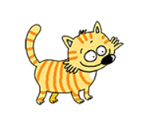
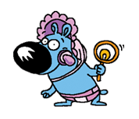
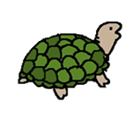
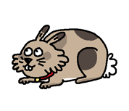
What’s missing ?

Slide 4
What’s missing ?

Slide 5
What’s missing ?

Slide 6
What’s missing ?

Slide 7
What’s missing ?

Slide 8
What’s missing ?

Slide 9
What’s missing ?

Slide 10
What’s missing ?

Slide 11
What’s missing ?

Slide 12
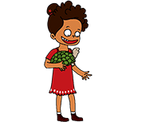
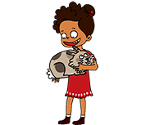
Listen and click on the right picture.
1/8

Slide 13
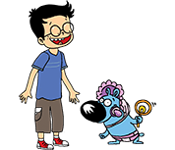
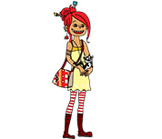
Listen and click on the right picture.
2/8

Slide 14
Listen and click on the right picture.
3/8

Slide 15
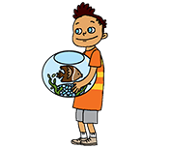
Listen and click on the right picture.
4/8

Slide 16
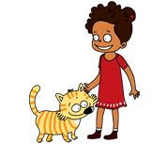
Listen and click on the right picture.
5/8

Slide 17
Listen and click on the right picture.
6/8

Slide 18
Listen and click on the right picture.
7/8

Slide 19
Listen and click on the right picture.
8/8

Slide 20
Look, listen and focus on what you understand.

Slide 21
Look, listen and focus on what you understand.
Tom: “What’s this?” Lucy: “This is a kitten! He’s so cute! It’s Tessa’s cat.” Tom: “Well, I prefer puppies!” Tessa: “Do you like pets?” Tom: “Yes, I do. This is my dog, Bingo!” Tessa: “Do you have pets Lucy?” Lucy: “Yes! This is my big grey rabbit, Jim and my small red goldfish, Jo!” Tessa: “They’re funny!”

Slide 22
What’s missing ?

Slide 23
What’s missing ?

Slide 24
What’s missing ?

Slide 25
What’s missing ?

Slide 26
What’s missing ?

Slide 27
What’s missing ?

Slide 28
What’s missing ?

Slide 29
What’s missing ?

Slide 30
What’s missing ?

Slide 31
Listen and click on the right picture.
1/8

Slide 32
Listen and click on the right picture.
2/8

Slide 33
Listen and click on the right picture.
3/8

Slide 34
Listen and click on the right picture.
4/8

Slide 35
Listen and click on the right picture.
5/8

Slide 36
Listen and click on the right picture.
6/8

Slide 37
Listen and click on the right picture.
7/8

Slide 38
Listen and click on the right picture.
8/8

Slide 39
What have we learned ?
What’s this ?
Amy’s big black dog.
What’s this ?
Lucy’s big grey rabbit.
What’s this ?
Lucy’s orange cat.

