Slide 1
NIVEAU 2
1- My Home
1.3- Pets
Step 1

Slide 2
Tongue Twister

Slide 3
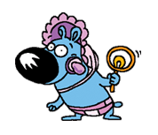
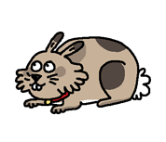
Listen and repeat

Slide 4
What’s missing ?

Slide 5
What’s missing ?

Slide 6
What’s missing ?

Slide 7
What’s missing ?

Slide 8
What’s missing ?

Slide 9
What’s missing ?

Slide 10
What’s missing ?

Slide 11
What’s missing ?

Slide 12
What’s missing ?

Slide 13
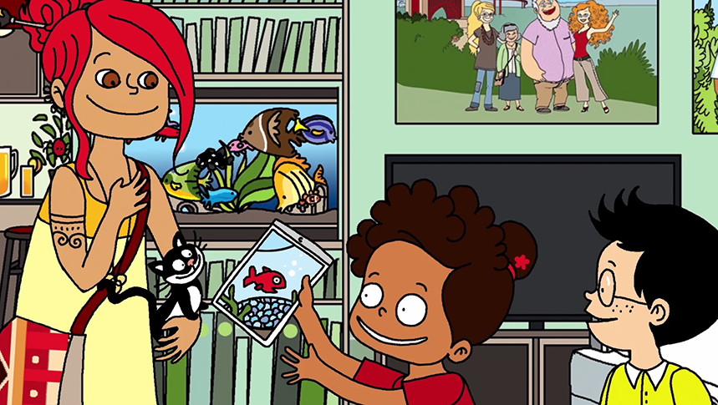
Look and say what you can.

Slide 14
Look, listen and describe.

Slide 15
What’s missing ?

Slide 16
What’s missing ?

Slide 17
What’s missing ?

Slide 18
What’s missing ?

Slide 19
What’s missing ?

Slide 20
What’s missing ?

Slide 21
What’s missing ?

Slide 22
What’s missing ?

Slide 23
What’s missing ?

Slide 24
What have we learned ?
an orange cat
a small green tortoise
a black and white kitten
a small pink fish
a big black dog
a big brown fish
a blue puppy
a big grey rabbit

