Slide 1
1- My Home
3 - My Pets
Step 2

Slide 2
Tongue Twister
Round and round the rugged rock the ragged rascal ran.

Slide 3
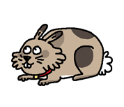
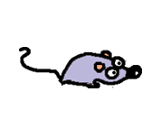
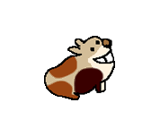
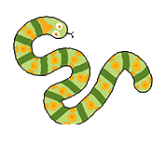
What’s missing ?

Slide 4
What’s missing ?

Slide 5
What’s missing ?

Slide 6
What’s missing ?

Slide 7
What’s missing ?

Slide 8
What’s missing ?

Slide 9
What’s missing ?

Slide 10
What’s missing ?

Slide 11
What’s missing ?

Slide 12
Listen and click on the right picture.
1/6

Slide 13
Listen and click on the right picture.
2/6

Slide 14
Listen and click on the right picture.
3/6

Slide 15
Listen and click on the right picture.
4/6

Slide 16
Listen and click on the right picture.
5/6

Slide 17
Listen and click on the right picture.
6/6

Slide 18
Look, listen and focus on what you understand.

Slide 19
Look, listen and focus on what you understand.
Tom: “What is it?” Lucy: “It’s a parrot!” Tom: “Is it your parrot?” Lucy: “No! It’s not.” Lucy: “Look! My big rabbit is here with Ben.” Tom: “What is it?” Lucy: “Ben is a guinea pig. He’s very small!” Tom: “Is it your pet?” Lucy: “No. It’s her guinea pig!” Tom: “Oh! You have a turtle too!” Lucy: “Yes, she’s really cute!” Tom: “And where is Jo? Where is your goldfish?” Lucy: “He’s in my bedroom!

Slide 20
Listen and click on the right picture.

Slide 21
Listen and click on the right picture.
4/6

Slide 22
Listen and click on the right picture.
2/6

Slide 23
Listen and click on the right picture.
1/6

Slide 24
Listen and click on the right picture.
3/6

Slide 25
Listen and click on the right picture.
6/6

Slide 26
Listen and click on the right picture.
5/6

Slide 27
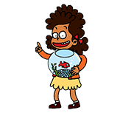
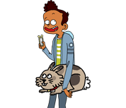
Listen and click on the right picture.

Slide 28
What have we learned ?
What is it ?
It’s a snake.
Is it a …?
Yes it is. / No it’s not.
Is it your dog ?
Yes, it’s my dog.
Is it her cat ?
Yes, it’s her cat.
Is it his mouse ?
No, it’s not his mouse.

