Slide 1
NIVEAU 2
1- My Home
2- Family
Step 2

Slide 2
Tongue Twister
I scream, you scream, we all scream for ice cream!

Slide 3
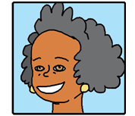
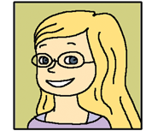
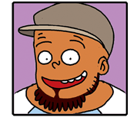
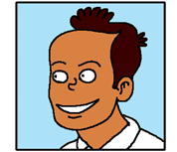
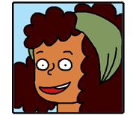
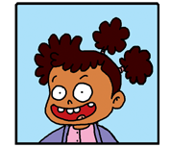
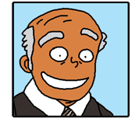
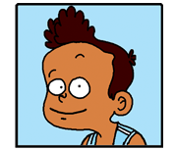
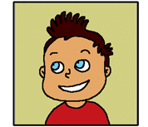
What’s missing ?

Slide 4
What’s missing ?

Slide 5
What’s missing ?

Slide 6
What’s missing ?

Slide 7
What’s missing ?

Slide 8
What’s missing ?

Slide 9
What’s missing ?

Slide 10
What’s missing ?

Slide 11
What’s missing ?

Slide 12
What’s missing ?

Slide 13
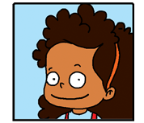
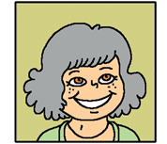
Listen and click on the right picture.
1/8

Slide 14
Listen and click on the right picture.
2/8

Slide 15
Listen and click on the right picture.
3/8

Slide 16
Listen and click on the right picture.
4/8

Slide 17
Listen and click on the right picture.
5/8

Slide 18
Listen and click on the right picture.
6/8

Slide 19
Listen and click on the right picture.
7/8

Slide 20
Listen and click on the right picture.
8/8

Slide 21
Look, listen and focus on what you understand.

Slide 22
Look, listen and focus on what you understand.
Tom: “I don’t understand? Who is Amy exactly?”
Lucy: “She’s Connor’s aunt!”
Lucy’s aunt: “Amy is my sister Tom! Look at this!”
Lucy: “Amy is Connor’s aunt... and this is Connor’s grandpa
and she is his grandma.”
Lucy’s aunt: “That’s right. This is my sister and they are my parents.”
Tom: “Ummmm... But who is he? Is he Amy’s brother?”
Lucy: “No Tom! He’s her husband!”
Tom: “Her husband? And who is he?”
Lucy: “Gavin is their baby!”
Tom: “Ohhh! I see...”

Slide 23
Listen and click on the right picture.
1/7

Slide 24
Listen and click on the right picture.
2/7

Slide 25
Listen and click on the right picture.
3/7

Slide 26
Listen and click on the right picture.
4/7

Slide 27
Listen and click on the right picture.
5/7

Slide 28
Listen and click on the right picture.
6/7

Slide 29
Listen and click on the right picture.
7/7

Slide 30
What have we learned ?
Is he Lucy’s brother ?
Yes, he is.
Is she Lucy’s mother ?
No, she isn’t. She is her grandma.
Is he Lucy’s uncle ?
No, he isn’t. He is her father.

