Slide 1
1- My Home
1.2- My family
Step 2

Slide 2
Tongue Twister

Slide 3
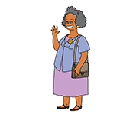
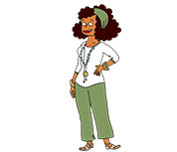
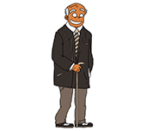
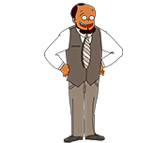
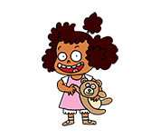
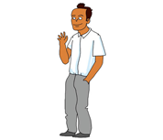
What’s missing ?

Slide 4
What’s missing ?

Slide 5
What’s missing ?

Slide 6
What’s missing ?

Slide 7
What’s missing ?

Slide 8
What’s missing ?

Slide 9
What’s missing ?

Slide 10
What’s missing ?

Slide 11
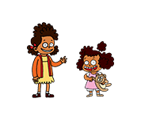
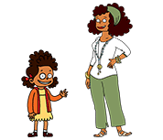
Listen and click on the right picture.
1/6

Slide 12
Listen and click on the right picture.
2/6

Slide 13
Listen and click on the right picture.
3/6

Slide 14
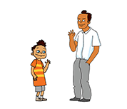
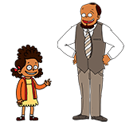
Listen and click on the right picture.
4/6

Slide 15
Listen and click on the right picture.
5/6

Slide 16
Listen and click on the right picture.
6/6

Slide 17
Look, listen and focus on what you understand.

Slide 18
Look, listen and focus on what you understand.
Tom: “Do you have a brother?”
Connor: “No, I don’t, but I have a big sister! Her name is Tessa.”
Lucy: “Look! She’s on the picture!”
Lucy: “This is his sister.”
Tom: “I see… So Tessa is your cousin!”
Lucy: “Yes, you’re right!”
Tom: “Who is this?”
Lucy: “This is my uncle Dan.”
Tom: “Who is this?”
Lucy: “This is my grandmother with my grandfather. They’re very nice!”

Slide 19
Listen and click on the right picture.

Slide 20
What’s missing ?

Slide 21
What’s missing ?

Slide 22
What’s missing ?

Slide 23
What’s missing ?

Slide 24
What’s missing ?

Slide 25
What’s missing ?

Slide 26
What’s missing ?

Slide 27
Listen and click on the right picture.

Slide 28
What have we learned ?
Who is this ?
This is my mother.
Do you have a brother?
Yes I do. / No I don’t.
Who is he ?
He is his father.
Who is she ?
She is her mother.

