Slide 1
1- My Home
2- My family
Step 1

Slide 2
Tongue Twister

Slide 3
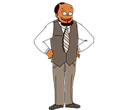
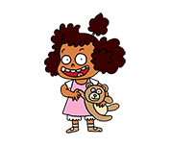
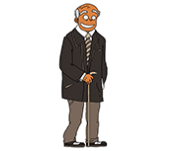
Listen and repeat

Slide 4
What’s missing ?

Slide 5
What’s missing ?

Slide 6
What’s missing ?

Slide 7
What’s missing ?

Slide 8
What’s missing ?

Slide 9
What’s missing ?

Slide 10
What’s missing ?

Slide 11
What’s missing ?

Slide 12
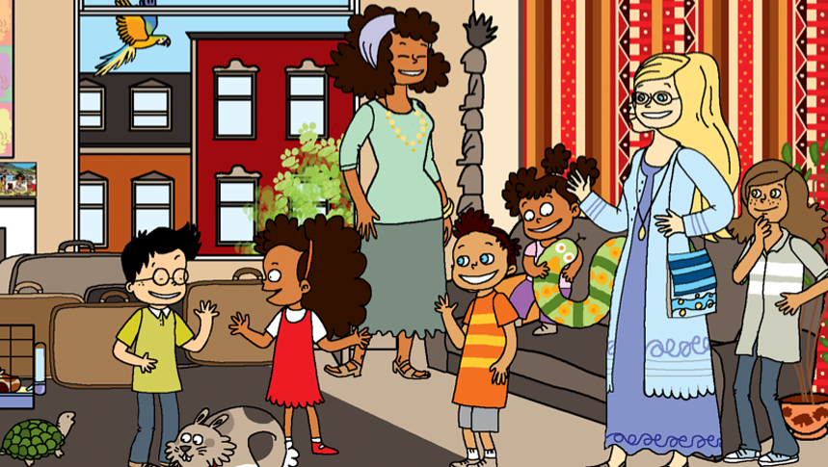
Look and say what you can.

Slide 13
Look, listen and describe.

Slide 14
What’s missing ?

Slide 15
What’s missing ?

Slide 16
What’s missing ?

Slide 17
What’s missing ?

Slide 18
What’s missing ?

Slide 19
What’s missing ?

Slide 20
What’s missing ?

Slide 21
What’s missing ?

Slide 22
What have we learned ?
mother
a sister
a father
a brother
grandmother
uncle
grandfather
aunt

