Slide 1
1- My Home
1.1- Describing Myself
Step 2

Slide 2
Tongue Twister

Slide 3
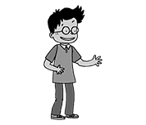
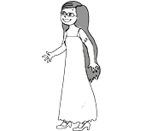
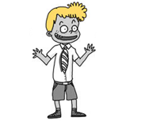
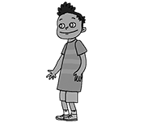
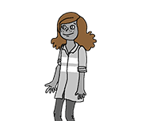
What’s missing ?

Slide 4
What’s missing ?

Slide 5
What’s missing ?

Slide 6
What’s missing ?

Slide 7
What’s missing ?

Slide 8
What’s missing ?

Slide 9
What’s missing ?

Slide 10
What’s missing ?

Slide 11
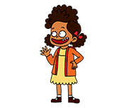
Listen and click on the right picture.
1/3

Slide 12
Listen and click on the right picture.
2/3

Slide 13
Listen and click on the right picture.
3/3

Slide 14
Look, listen and focus on what you understand.

Slide 15
Look, listen and focus on what you understand.
Lucy’s aunt : “Welcome back! How are you?”
Lucy’s mother : “Good afternoon!”
Connor (Lucy’s cousin) : “Hi! What’s your name?”
Tom : “Hello! My name’s Tom! What’s your name?”
Connor : “My name’s Connor.”
Tom : “How old are you?”
Connor : “I’m 9 years old. What about you?”
Tom : “I’m 8.”

Slide 16
Look and listen.
My name is Tom.
I’m a boy.
I have short black hair.
I have brown eyes.
I am 8 years old.

Slide 17
Listen and click on the right picture.
1/2

Slide 18
Listen and click on the right picture.
2/2

Slide 19
What have we learned ?
What’s your name ?
My name is …
I’m a boy / I’m a girl.
How old are you ?
I’m ten years old.
I have long brown hair.
I have short black hair.

